Slide 1
PULLING BACK THE CURTAIN
Strategies for communicating with the public
Dr. Zach Constan
Outreach Coordinator
Facility for Rare Isotope Beams (FRIB)

Slide 2
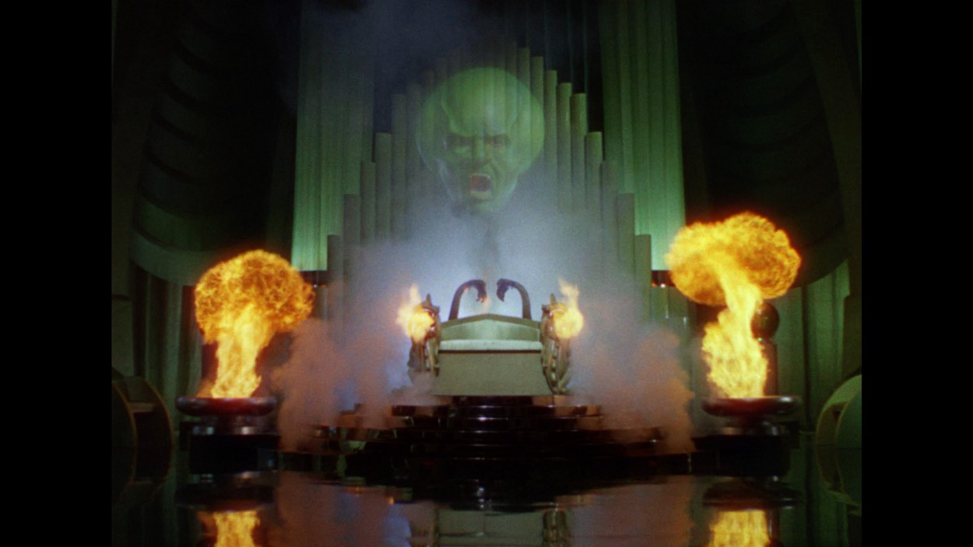
“I am SCIENCE, the Great and Powerful!”
©MGM 1939, 1967

Slide 3
What impressions does this give you? How does it make you feel?
Strange/alien
Mysterious
Intimidating
Impressive
©MGM 1939, 1967

Slide 4
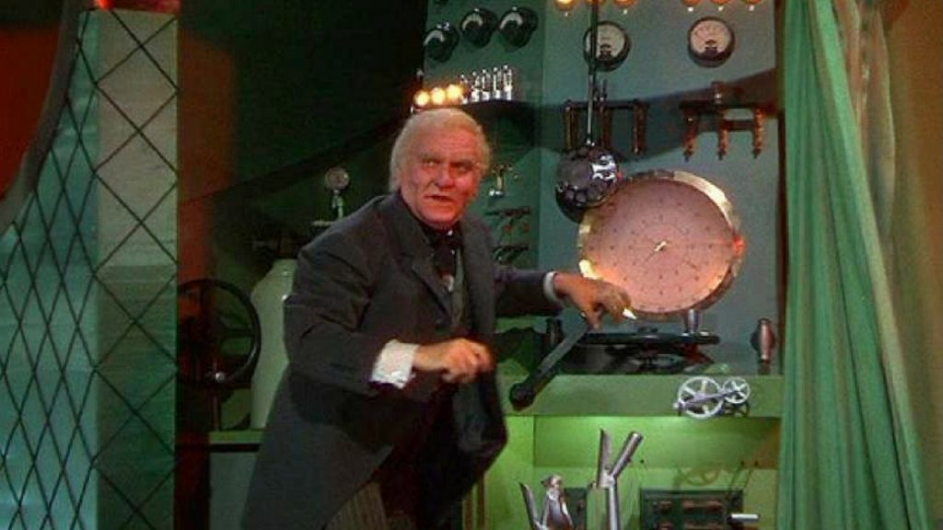
“Pay no attention to the scientist behind the curtain!”
©MGM 1939, 1967

Slide 5
What impressions does this give you? How does it make you feel?
Complicated
Interesting
Relatable/approachable
Human
©MGM 1939, 1967

Slide 6
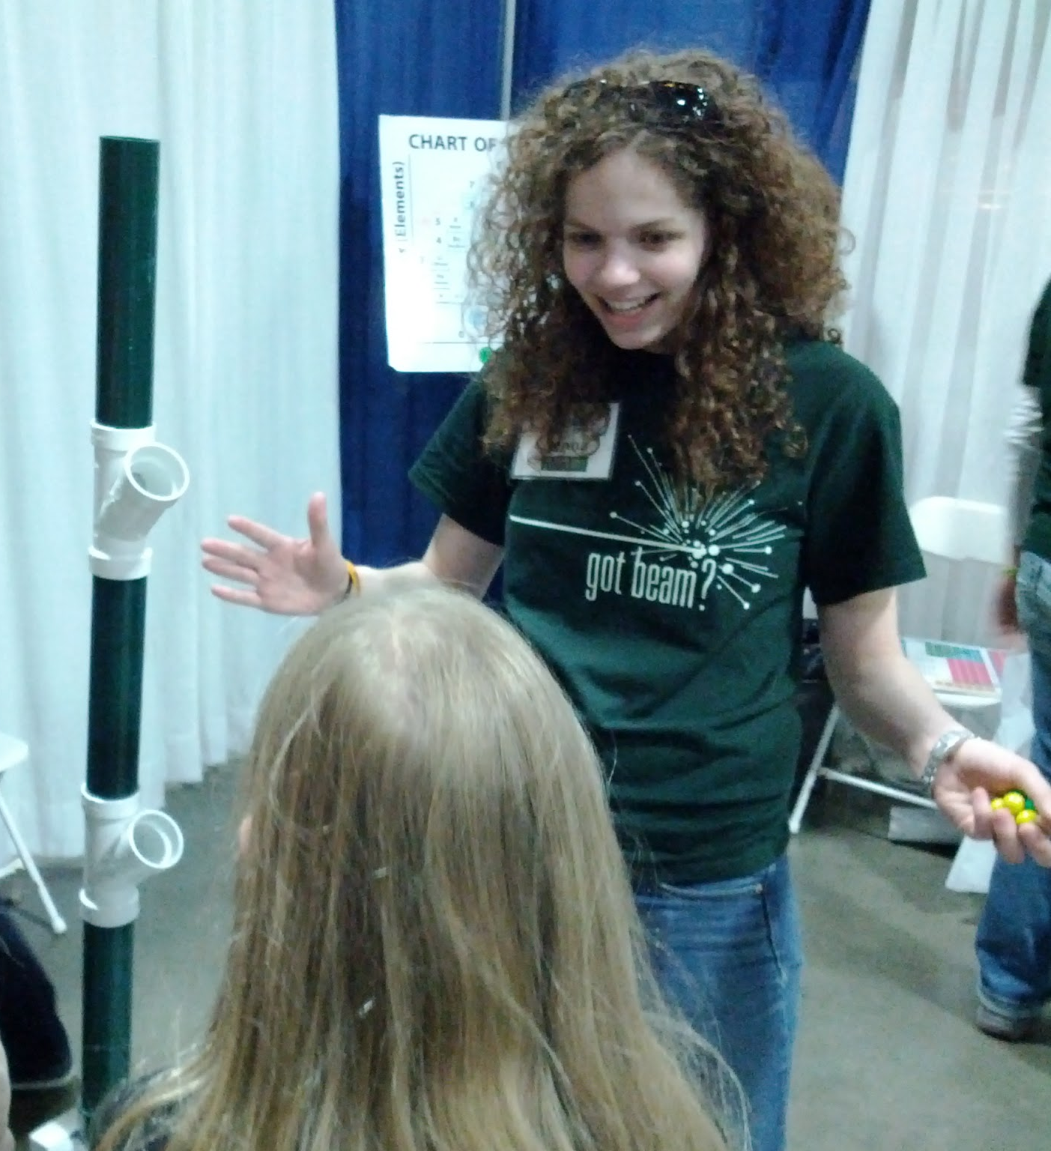
Why communicate with the public?
Connect with humans! The value of outreach is:
Sharing why your work is important
Spreading the excitement (& maybe rekindling your own)
Correcting misconceptions
Knowing you have made a difference in others’ lives
Creating a brighter future for humanity
Outreach benefits BOTH volunteers AND the community!

Slide 7
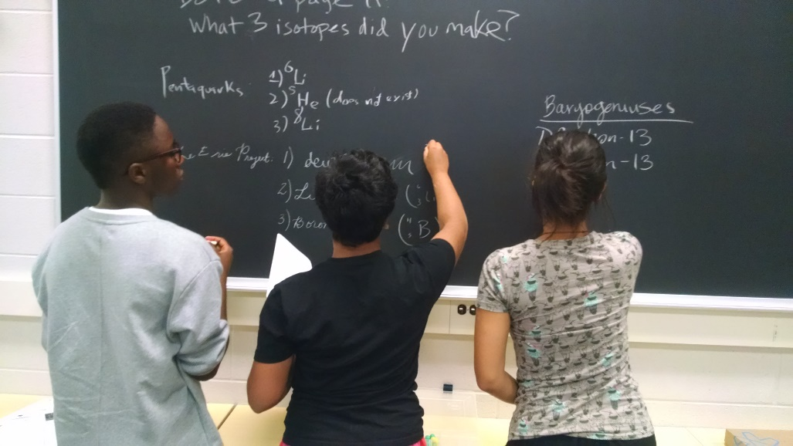
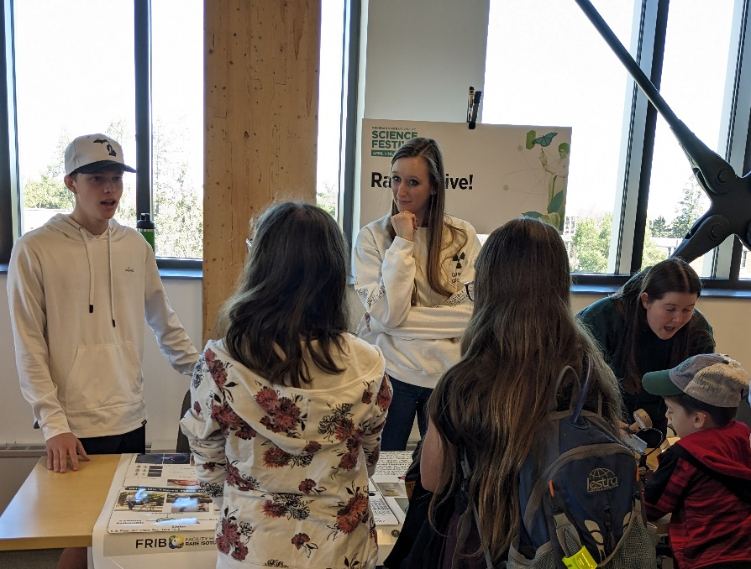
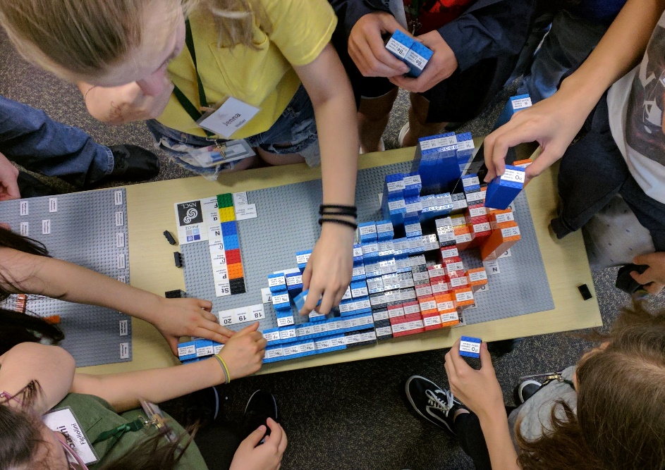
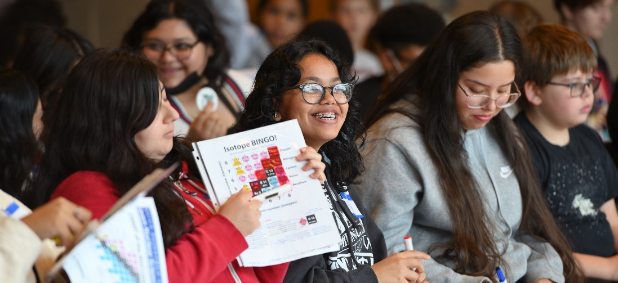
Who has stepped up before?
Have you ever performed:
Public Outreach
Community Engagement
Informal Learning
Science Communication
Whatever you call it

Slide 8
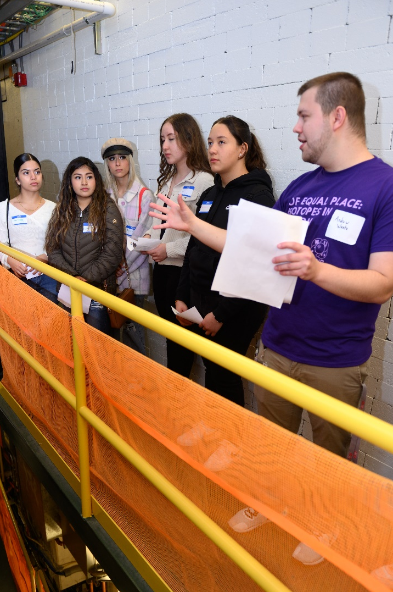
Know your goals
What do you want to communicate?
Focus on the BIG IDEA
Who is your target audience?
How/where/when can you communicate to them?
What should they be able to tell friends/family?
What can you actually teach?
With informal education: not much!
Keep your expectations reasonable
HOW does this topic affect THEM?
Keep focused on the message
How can you make a long-term impact?
Introduce your audience to something new
Give them ideas and tools for the future
Change attitudes
!!

Slide 9
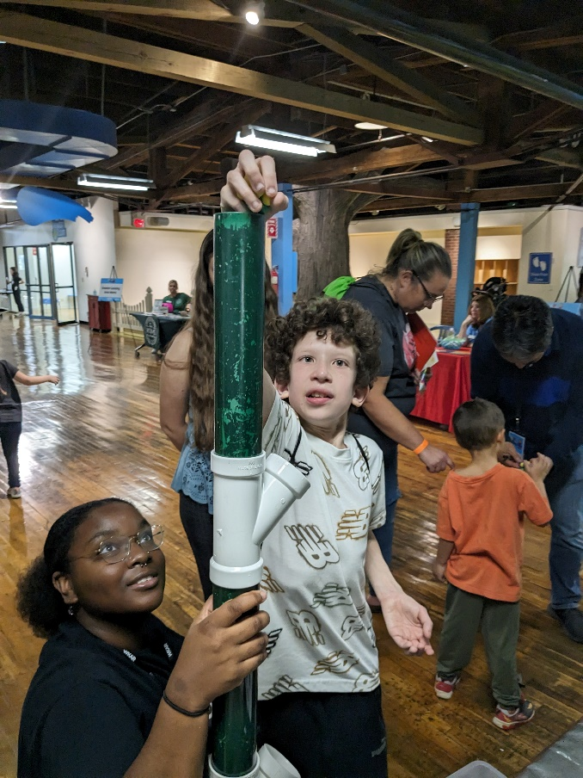
Evidence of changed attitudes
FRIB has collaborated with the MSU College of Education to perform program assessments.
Attitudes recorded before outreach experience:
Curiosity
Anxiety
Intimidation
Confusion
Bewilderment
Disinterest
Attitudes taken from post-surveys of attendees:
Amazement
Interest
Excitement
Inspiration
Enthusiasm
Gratitude

Slide 10
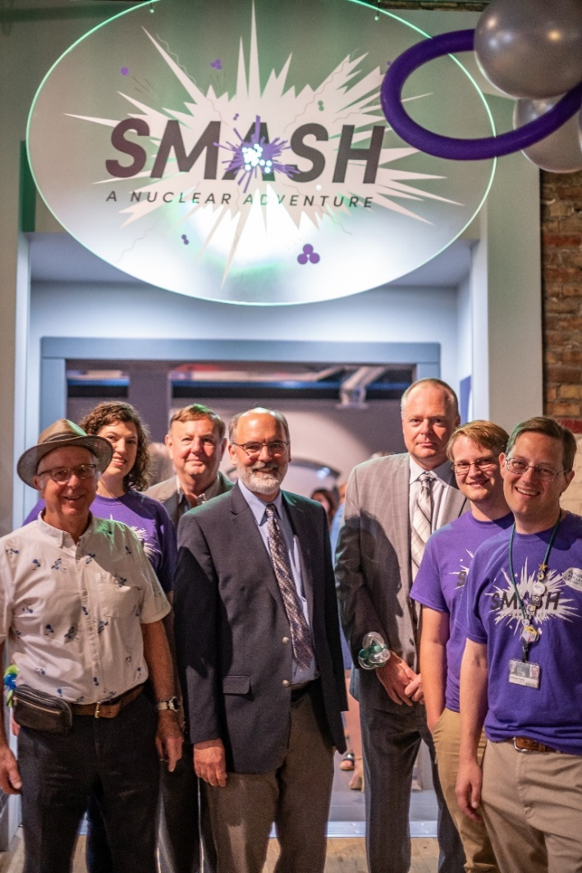
Benefits of changed attitudes
Informed voters and taxpayers
Positive word-of-mouth
Lessened fear of unknown
Excitement for future discoveries
Recruiting future researchers
Analysis shows that alumni from our PAN program for high school students are
9x more likely to choose a STEM major
8x more likely to choose a STEM career
In the last 10 years, hundreds of students have chosen to attend MSU (and often major in physics!) because of interaction with FRIB
Outreach benefits BOTH volunteers AND the community!

Slide 11
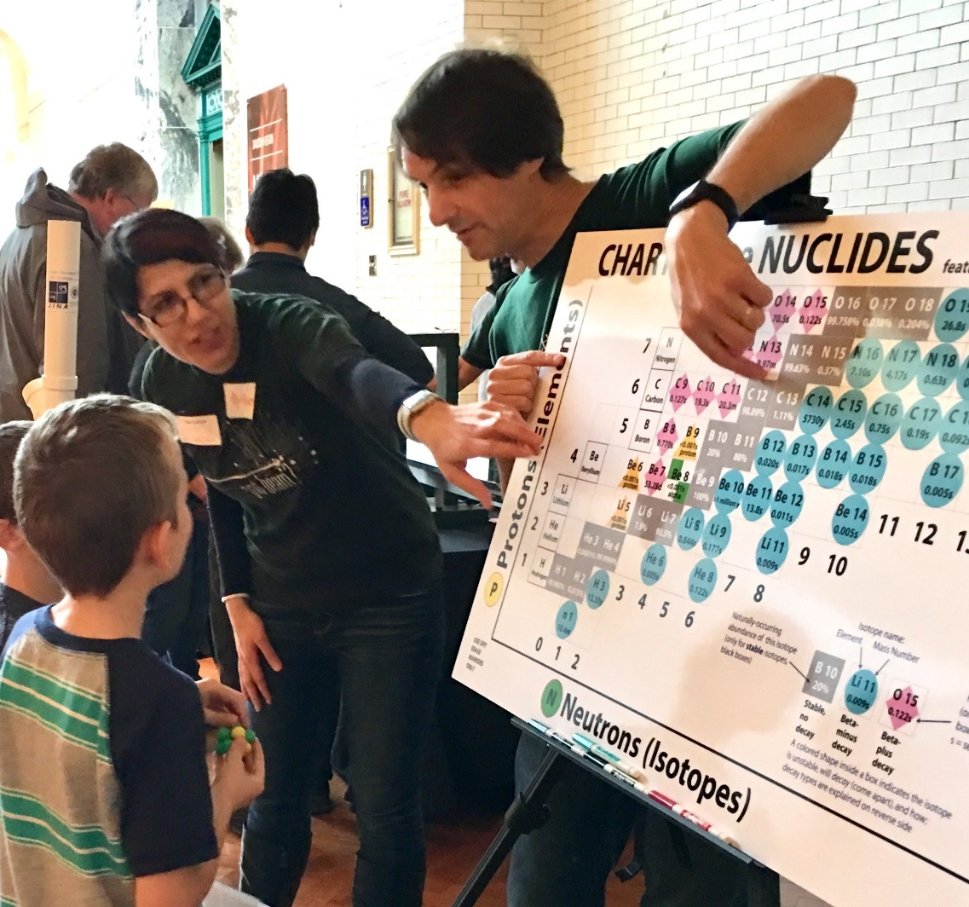
How you communicate matters
What big idea (research question or goal) will you share with the public?
Why are you excited about this idea, and why should they be?
Which words/images/other convey the idea most effectively?
What will amuse, educate, enlighten, and inspire your audience?
How can you present effectively?
How will you keep your audience engaged?

Slide 12
Discussion Question #1
FORM A GROUP OF 3-5 PEOPLE
Think of your BIG IDEA: an example topic or concept that you want to convey to the public!
Consider carefully: WHY do you want to convey that information?
Watch the timer and make sure everyone gets a turn!
Critical lesson that you should have picked up in research: ALWAYS WRITE IT DOWN

Slide 13
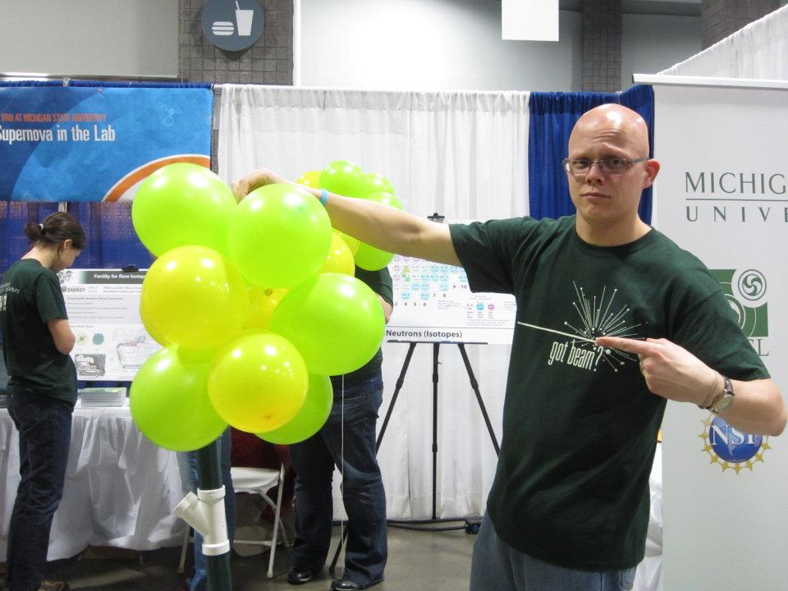
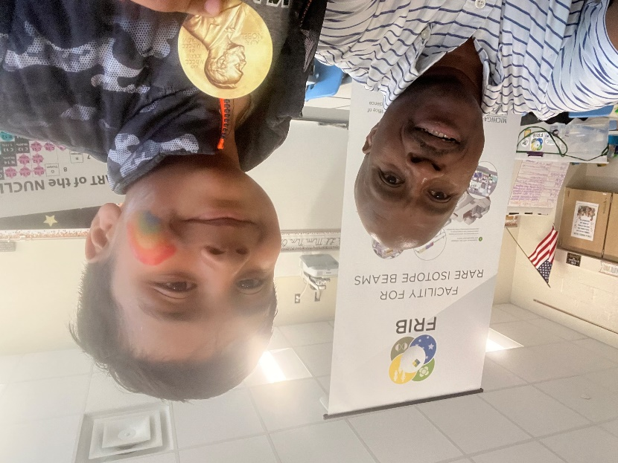
What is “the hook” to catch their attention?
AMUSE | Humor is a great way to engage They will remember enjoyment
ENLIGHTEN | Increase understanding Cause a realization or connection Nothing beats the “light bulb” moment
EDUCATE | Kind of the point! Provide new information Humor is a gateway to learning
INSPIRE | Influence future choices Spark their imagination What will they do next?

Slide 14
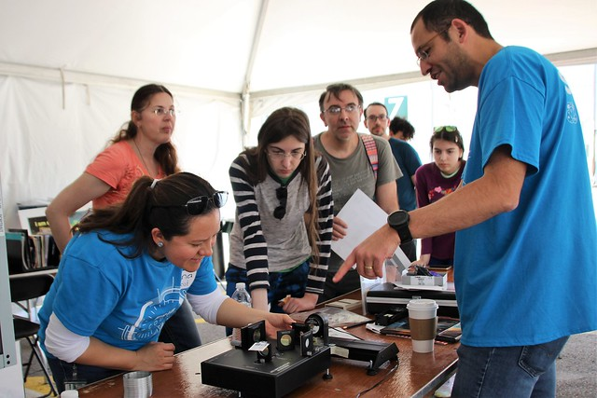
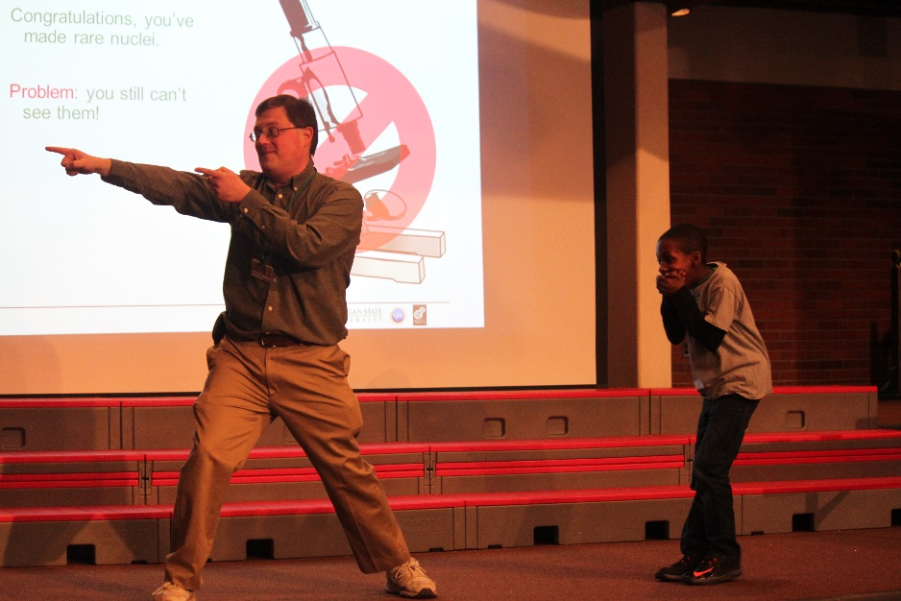
Example “hooks”
SMASHING PARTICLES AT HIGH SPEEDS WHO’S HAD AN MRI? $10 MILLION POWER BILL, ENOUGH FOR 30,000 HOMES | MADE OF STAR STUFF MOST TYPES OF NUCLEI ARE UNDISCOVERED SEEING THE UNSEEN | SOUNDS DANGEROUS: RADIATION, HIGH VOLTAGE, FREEZING TEMPS, ETC. RECREATING A SUPERNOVA WEIRD NUCLEI: FOOTBALL, PASTA, HALO

Slide 15
Discussion Question #2
DISCUSS WITH SAME 3-5 PEOPLE
How can your BIG IDEA amuse, educate, enlighten, and inspire your audience?
What is “the hook” that will catch their attention/pique their curiosity?
What is inherently odd/surprising?
How could this affect humans in our past, present, and/or future?
Watch the timer and make sure everyone gets a turn!
Critical lesson that you should have picked up in research: ALWAYS WRITE IT DOWN

Slide 16
Communication Challenges & Strategies
Relate to current news or the audience’s experiences
Tell the story about people, it’s easier to relate
What is your own story?
How do you relate to the topic/place/equipment at hand?
Explain why you love this topic/ find it interesting and important.
The audience will respond to your energy!

Slide 17
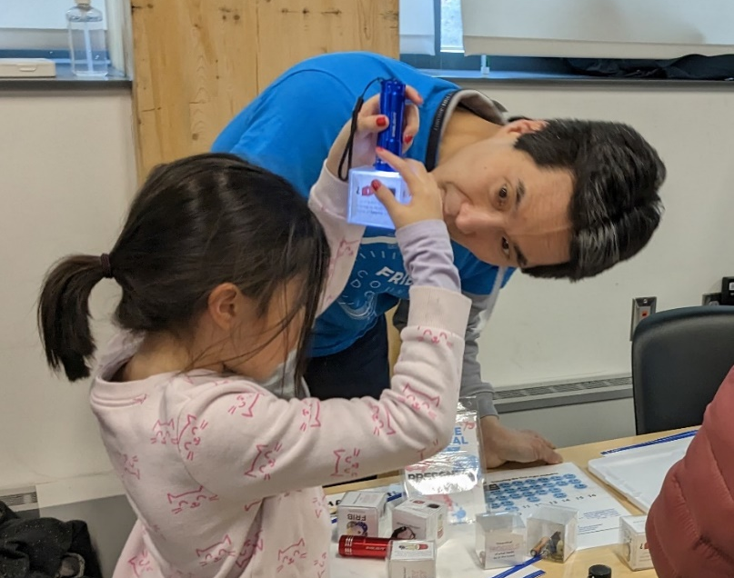
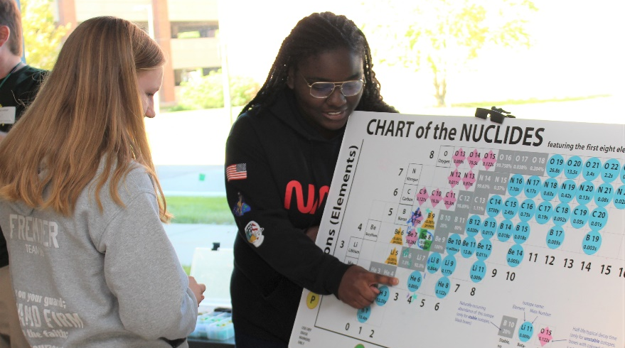
Constructing Your Message
Offer analogies
e.g. collecting detector data is like forensic science
Avoid jargon
Catch their interest
Something unexpected?
How is the BIG IDEA relevant to everyday life?
Address misconceptions
Debunk fictional characters
Explain terminology
Refute the notion that they can’t understand/participate in your field

Slide 18
Discussion Question #3
DISCUSS WITH SAME 3-5 PEOPLE
Why are you excited about your BIG IDEA? Why should the public be excited about it?
How is it meaningful? How could it affect the lives of your audience? In other words, “who cares?”
Watch the timer and make sure everyone gets a turn!
Critical lesson that you should have picked up in research: ALWAYS WRITE IT DOWN

Slide 19
Tuning Your Communication
Optimize for your audience!
What age range?
What levels of content knowledge?
Which terms and info are unnecessary?
What misconceptions might they have?
How will you engage?
???

Slide 20
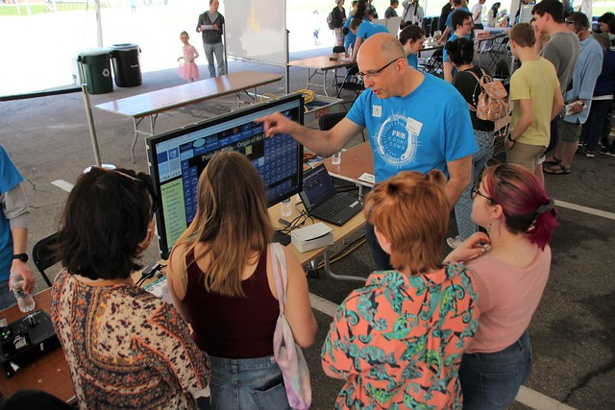
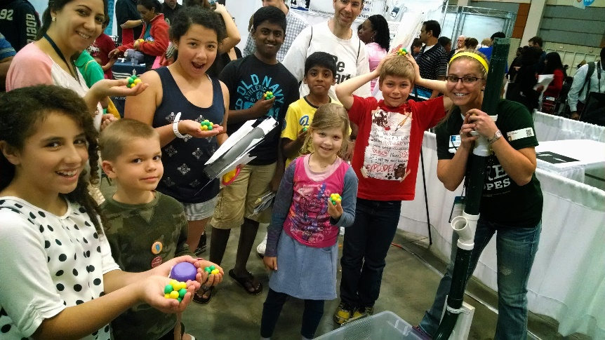
Talking to the public
Communicate in multiple ways
Spoken-word explanations
Visual aids
Gestures/movement
Models/objects
Physical demonstrations are a big plus! What could your audience DO to understand your BIG IDEA more?
Speak as you would to a friend, be natural
Project your voice, think about talking to the person in the back
Maintain a pace that is quick but not rushed – keep the energy up

Slide 21
Connecting with your audience
Smile! Make eye contact
Talk TO them, not AT them
Move around your space, keep things active
Watch their expressions & body language and adapt as needed
Ask them about their experiences, opinions, predictions
Reiterate how this affects THEM
Have them imagine themselves doing/supporting research in your field
With a general audience, there is no substitute for enthusiasm

Slide 22
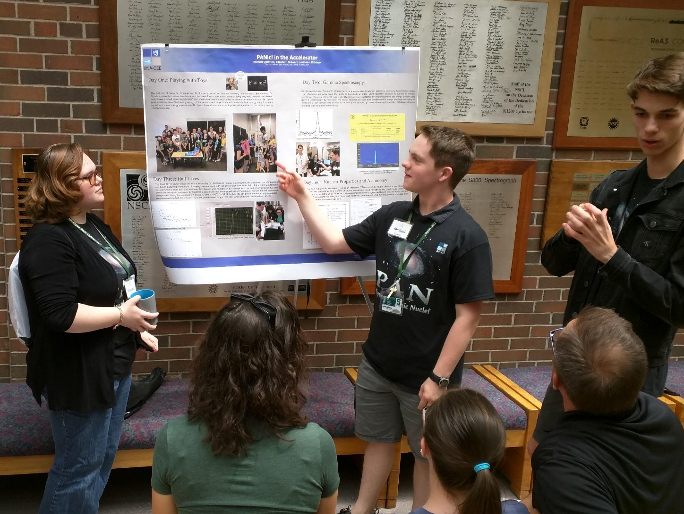
Getting the point across
An “elevator speech” is a valuable tool!
How could you “sell” your big idea with just 20 seconds?
Useful when time is short or as a thesis statement for your presentation

Slide 23
Discussion Question #4
DISCUSS WITH SAME 3-5 PEOPLE
How can you present your BIG IDEA most effectively?
Try to convince your group in one or two sentences (an elevator speech)!
Use what you’ve learned so far!
Use your “hook” and/or why it’s interesting
How can they interact during your explanation?
How could it relate to their personal experience?
What presenting techniques can you use?
Critical lesson that you should have picked up in research: ALWAYS WRITE IT DOWN

Slide 24
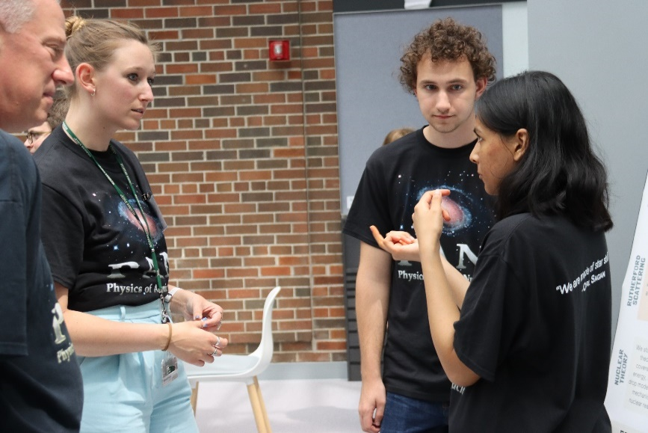
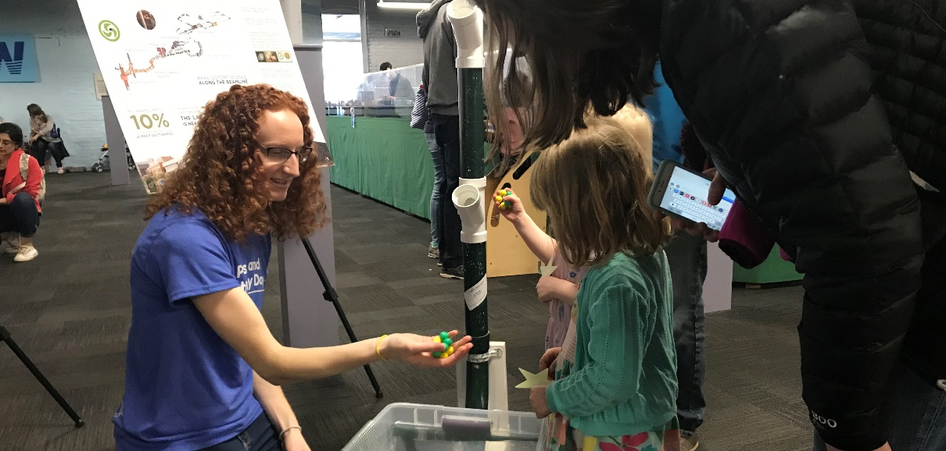
The best way to learn it is to do it
No plan survives first contact with the audience
You won’t get it right the first time (or second…)
It’s never really “done”
Experience is a great teacher!
Rehearse
Present to an audience when possible
Watch audience reactions
Try different approaches
Think about your message!
Practice makes perfect improvements

Slide 25
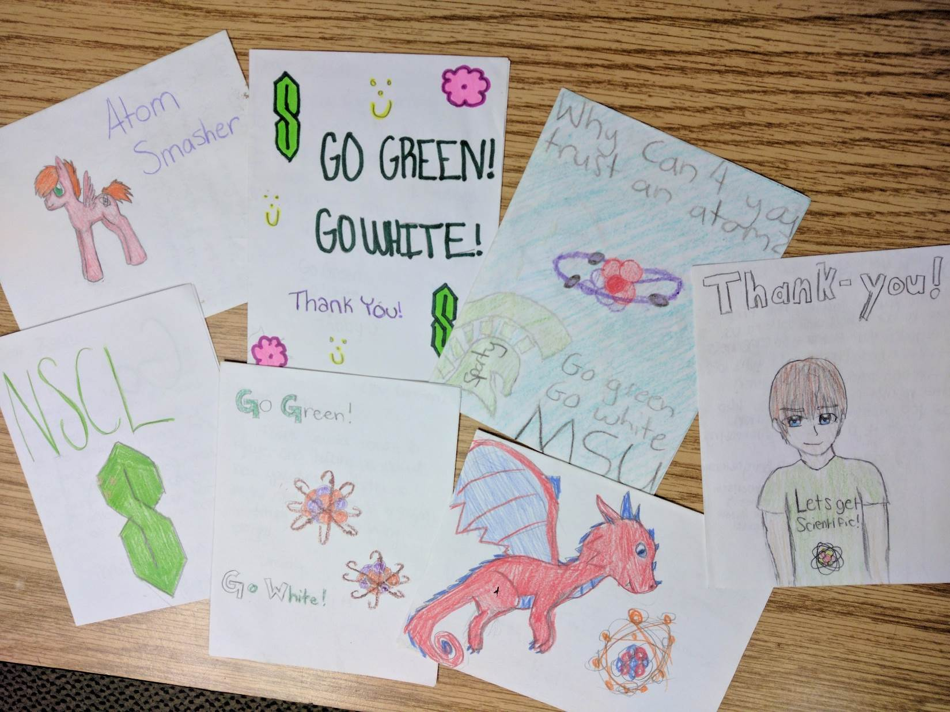
We make an impact
Some thank-you cards from kids who visited NSCL (in the time before FRIB)

Slide 26
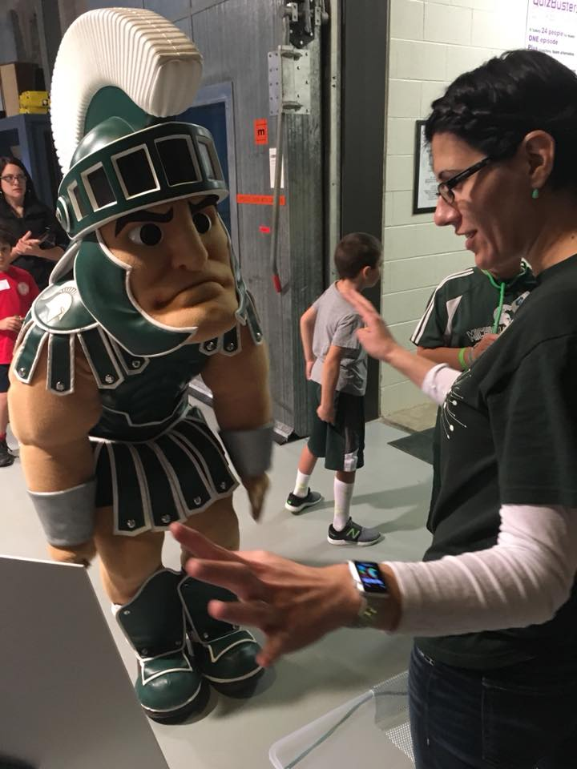
What will they remember?
Not much
Hopefully your BIG IDEA
The way(s) that they felt you connected with them
Any surprises
Whether they enjoyed themselves
Remember: outreach benefits
BOTH volunteers AND the community!

Slide 27
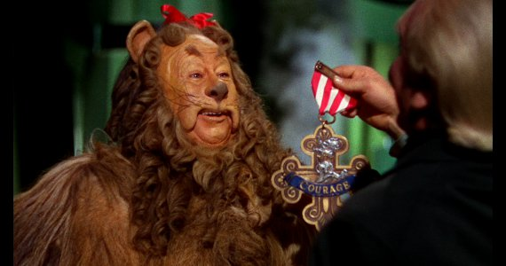
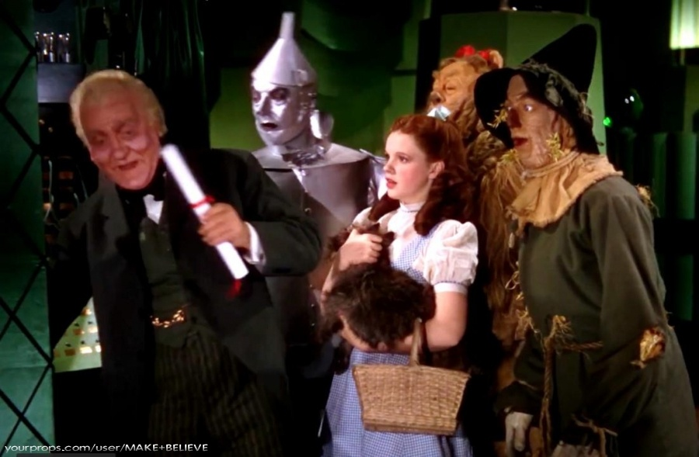
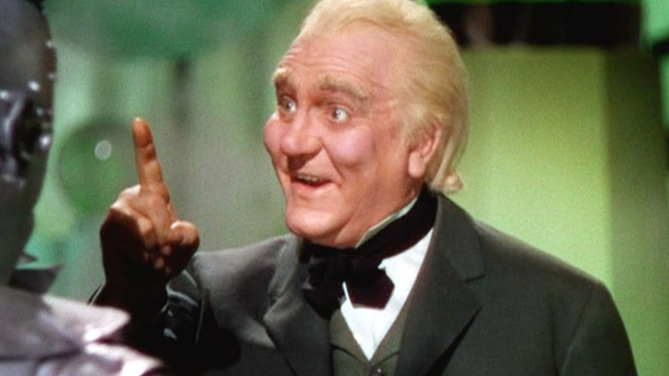
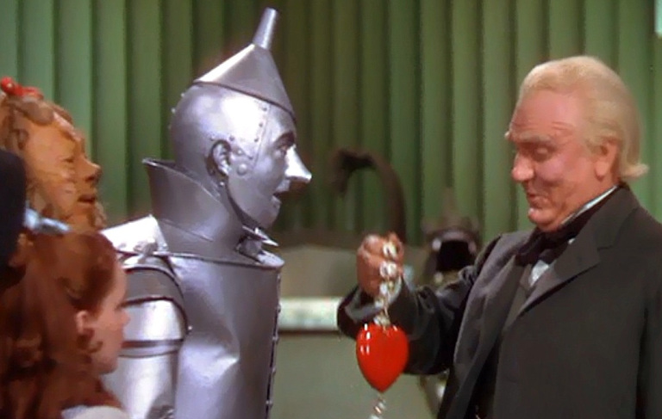
Maybe you can’t grant wishes, but you can still change lives
©MGM 1939, 1967
Notes:
“About 2 years ago I took a one-day class on nuclear physics with you at MSU. In part, due to that class, I decided to enlist in the United States Navy as a Nuclear Propulsion Engineer. Sometime within the next 8 months, I’ll be on the operations team of a naval nuclear reactor on a submarine.”

Slide 28
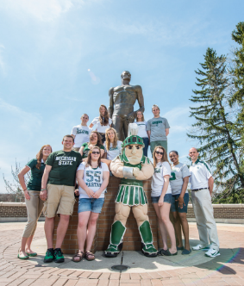
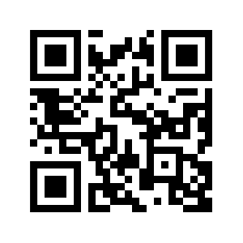
Explore FRIB at MSU
Learn more about our Lab and outreach programs
Visit the FRIB exhibit at Impression 5 Science Center in downtown Lansing!
impression5.org
SPARTAN YOUTH PROGRAMS
Find camps and programs at MSU for
pre-college students: spartanyouth.msu.edu
Each April, explore the MSU Science Festival!
sciencefestival.msu.edu
Visit our Gift Shop on shop.msu.edu (click “FRIB” under “Specialty Shops”)
Get the Android/ iPhone/iPad game Isotopolis for free!
GIFT SHOP
contact visits@frib.msu.edu or go to frib.msu.edu/public
@friblab

Slide 29
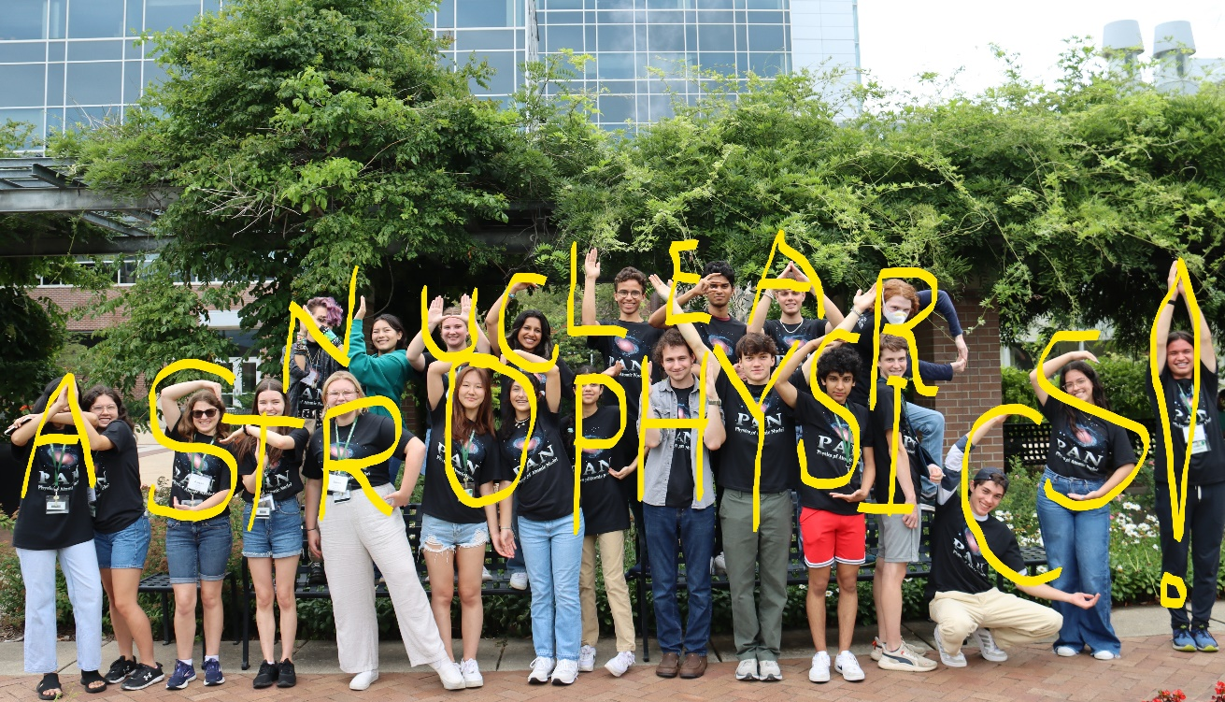
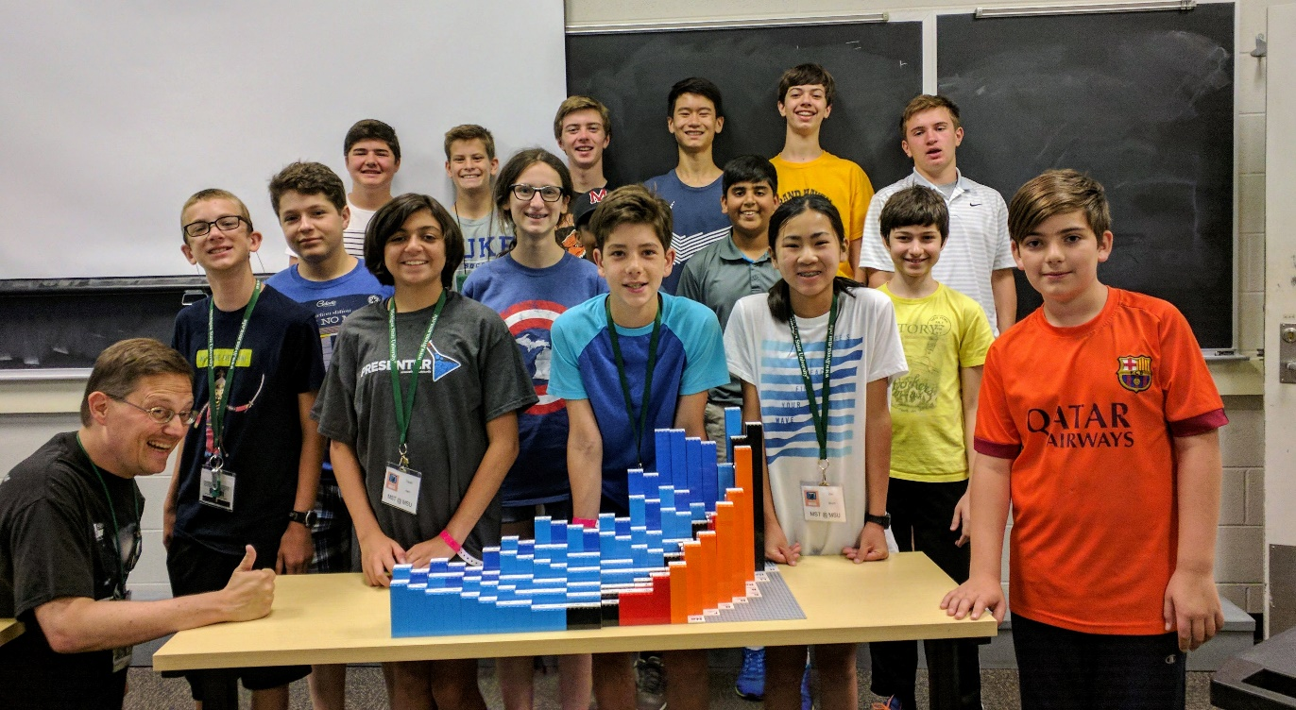
Outreach opportunities THIS SUMMER – email me
Physics of Atomic Nuclei (PAN)
24 HS students
Seeking a male chaperone to live in Shaw Hall with them 7/21-7/26
Only responsibilities are in the evenings, this will not impact your daily work!
MST (grades 7-8) and GUPPY (grades 5-6)
Seeking a panel of REUs to talk about your research & how you got into physics
GUPPY 7/11 4:00-4:30pm
MST 7/12 12:15-1:00pm

Slide 30
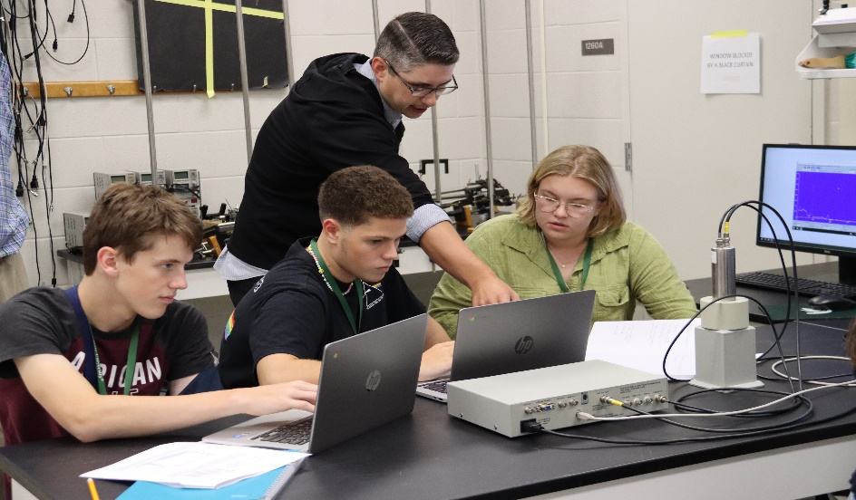
Professional Development for YOU
By popular demand, this is the first in a planned series of Professional Development (PD) events for FRIB grads & post-docs
Include this in your CV or anywhere you report training!
Fun fact: faculty applications may require a statement about community engagement
How can we help you?
What type(s) of PD do you want?
FRIB will contribute talks/booths at many events in the spring, so watch for our call for volunteers!

