Slide 1
HPECR 28GHz Gyrotron
Recovery Instructions
Haoyu Cheng
Ion Source Engineer
September 30th, 2025

Slide 2
HPECR 28GHz Gyrotron recovery instructions
Notice:
During the beam operations, when there is no beam out of HPECR, the initial action is to verify the interlock status of 28GHz Gyrotron.
If an interlock trip has occurred, the associated PLC interlocks and latches must be reset within 60 seconds. Failure to do so will require intervention by authorized personnel, who must enter the HPECR high-voltage (HV) cage and perform a power cycle of the Gyrotron cabinet to restore RF output.

Slide 3
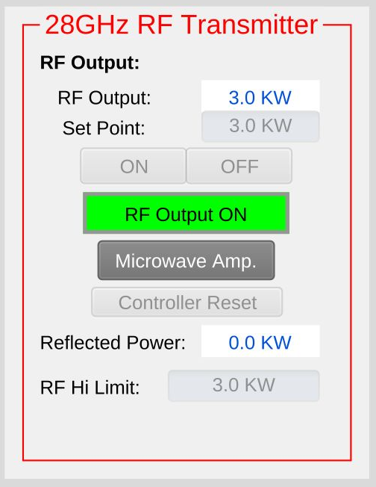
HPECR 28GHz Gyrotron recovery instructions
On the HPECR Operator page
  At the lower left corner of the page, Click on
  “Microwave Amp.” to access the 28GHz Gyrotron page “28GHz_RF”.

Slide 4
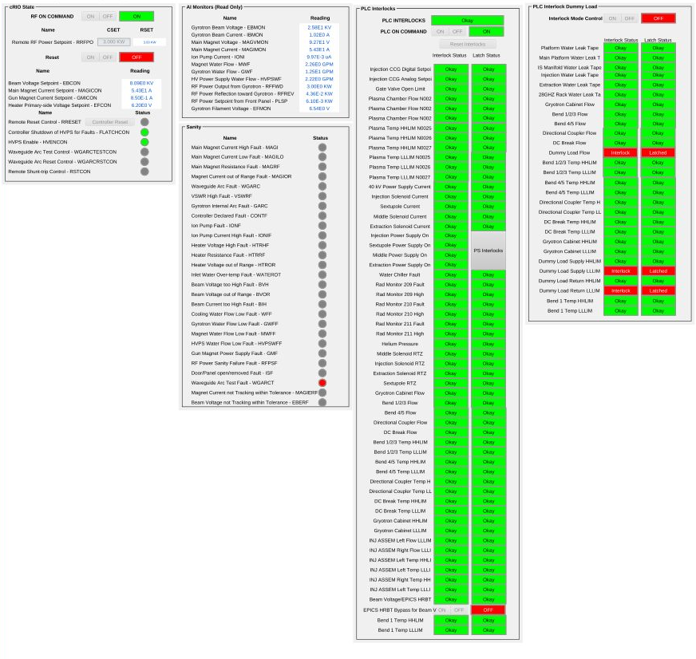
HPECR 28GHz Gyrotron recovery instructions
On the 28GHz_RF page
  During the normal operation, please ignore interlocks in the section “PLC Interlock Dummy Load”. Make sure the “Interlock Mode Control” turn OFF.
OFF

Slide 5
HPECR 28GHz Gyrotron recovery instructions
iii. On
On the 28GHz_RF page
  In the section “PLC Interlocks”
    Click on “Reset Interlocks” to remove all interlocks and latches. Please contact the person on-call if the interlocks cannot be removed by resetting.
    Leave “EPICS HRBT Bypass for Beam V” OFF.
    Turn ON “PLC ON Command”.
i. Reset
ii. OFF

Slide 6
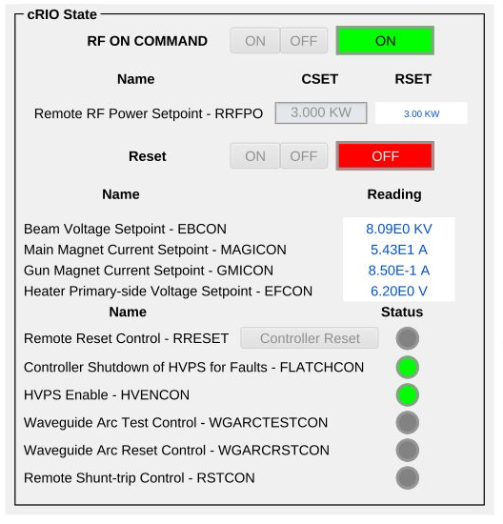
HPECR 28GHz Gyrotron recovery instructions
On the 28GHz_RF page
  In the section “cRIO State”
    Write ZERO into the Remote RF Power Setpoint – RRFPO.
    Turn ON the “RF ON Command” to turn back on the beam high voltage. (When Gyrotron is tripped off, this will be OFF in RED.) You should see the following:
    EBCON: start ramping from -2.75E-4 KV to 7.75E0 kV
ii. Turn ON
i. Write Zero

Slide 7
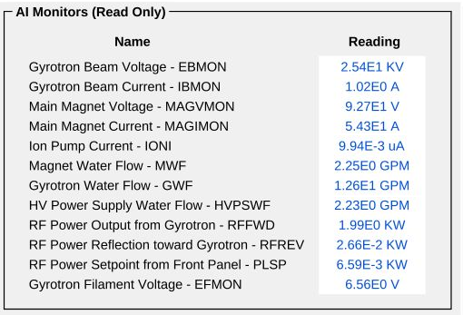
HPECR 28GHz Gyrotron recovery instructions
On the 28GHz_RF page
  In the sections “AI Monitors” and “cRIO State”
    Wait the “Gyrotron Beam Current – IBMON” to be at least 9.00E-1 A (0.9A) before moving on to the next step.
    Ramp up RF output to a desired level by 0.5kW/step.
iv. Ramp up RF by 0.5kW/step
iii. Monitor beam current

