Slide 1
CAPACITANCE TESTS
Tested 4 Micromegas
All Measurements made with Sencore Inductance/ Capacitance Meter
Checked capacitance of several connectors, including the 100 and 60 pin SMT we plan to use on the prototype

Slide 2
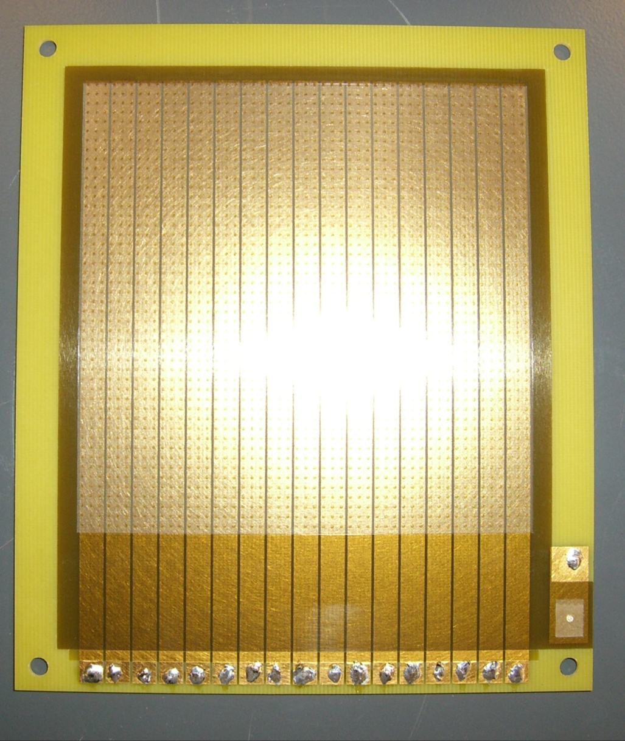
What we Measured?
Anode Plane Connection
Channel Connection * 17

Slide 3
RESULTS
BOARD1, TEST #1→ Between the anode plane and the channels=
115-120pF
BOARD 1, TEST #2→ Between channels= 50-60 pF
When shorting out all channels and taking capacitance= 1370pF/ 17pF= 80pF/ Channel

Slide 4
RESULTS, continued
BOARD #2, TEST #1→ Between anode plane and channel= 140-150pF
BOARD #2, TEST #2 → Channel to channel= 50-60pF
BOARD #3 (1 CHANNEL ONLY)= 1150pF
BOARD #4 (I CHANNEL ONLY)= 1250 pF

Slide 5
RESULTS, cont.
C=(κ*ε₀*A)/d
Between Anode plane and Channel, based on calculation alone…
C=33pF (We got anywhere btwn. 110-150pF)
The capacitance of the connectors was negligible, and did not even register on the meter… this might change when we consider the dense traces running to the connectors.

Slide 6
RESULTS, cont.
Our capacitance is a FACTOR OF 3-5 higher than what it is calculated to be.
Possible reasons???
Dielectric constant of the spacers
Field between the channels and the much larger anode plane is not perpendicular at the edges
John Yurkon might know more (Absent until Monday)

