Slide 1
Update of Prototype AT-TPC Tests of micromegas
May 27, 2010
Weekly meeting
Claire Hewko, NSCL

Slide 2
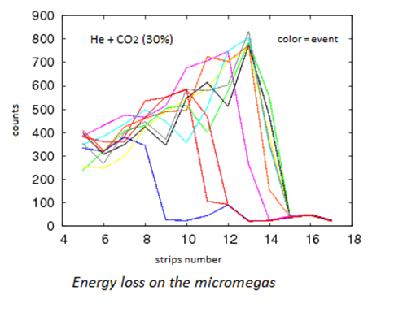
Energy loss in the strips of the micromegas
The energy loss profile of theses events is too fluctuant compared to the profile calculation
May be charges are collected by the wrong strips next to the good one
We looked for the total charge collected by the micromegas

Slide 3
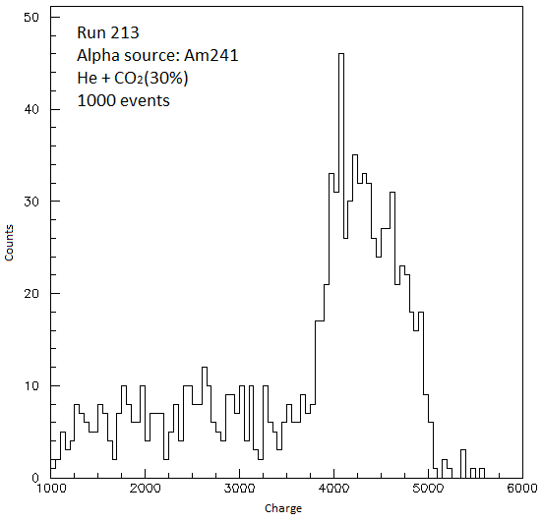
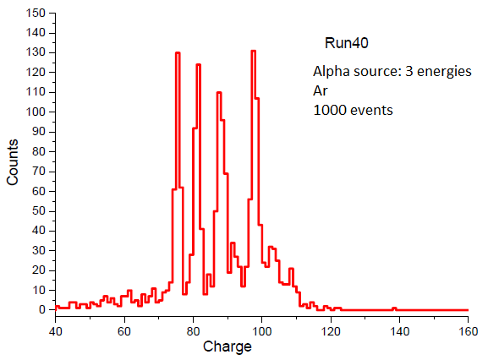
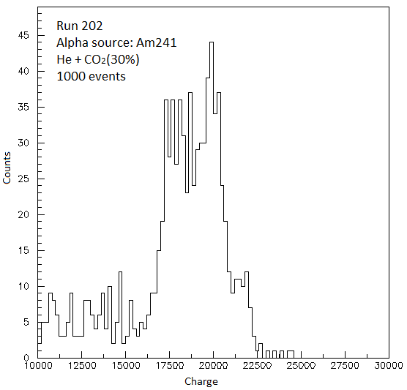
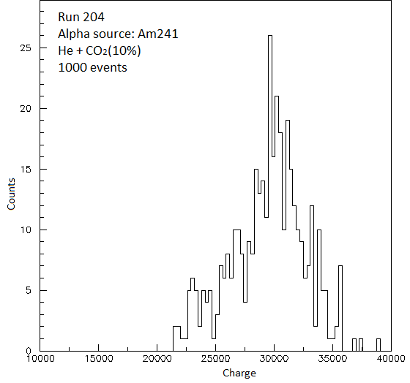
Charge resolution
Run 40 : 5%
≠ gas
≠ micromegas
Run 213 : 20%
Run 202 : 20%
Run 204 : 16%

Slide 4
Origins and issues propositions for these unusable results
Not an analysis problem but rather a physics cause?
Origins and issues propositions:
All the charges are not collected by the strips, too much diffusion
→ increase the cathode voltage?
The micromegas is not good
→check the alpha source resolution with Ar gas to compare the results of the Run 40
Others propositions?

