Slide 1
Update of Prototype AT-TPC
June 3, 2010
Weekly meeting
Daisuke Suzuki, NSCL

Slide 2
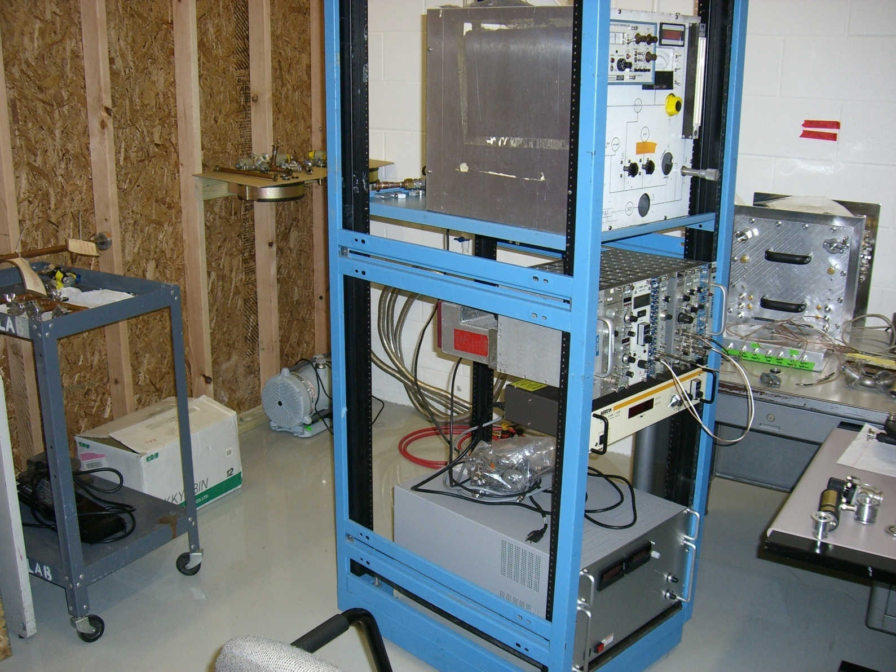
This week
Gas handler, power supply were moved on the rack.
Scroll pump arrived. The vacuum tubes are being cleaned up.
Clean room accessories arrived.

Slide 3
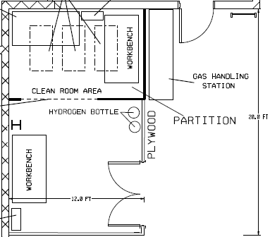
Future layout
12 ft
Scale = 40”/1”
24” x 24” x 74”
Wire rack
36” x 24” x 74”
Desk 01
97”
36”
Gas bottle
21”1/4
47”3/4
Cabinet 2
21.5”
12”
Desk 05
Desk 02
45.5”
118.5”
Gas handler
Rack
Utilities
77.5”
Desk 03
Desk 04
Tool box
17”

Slide 4
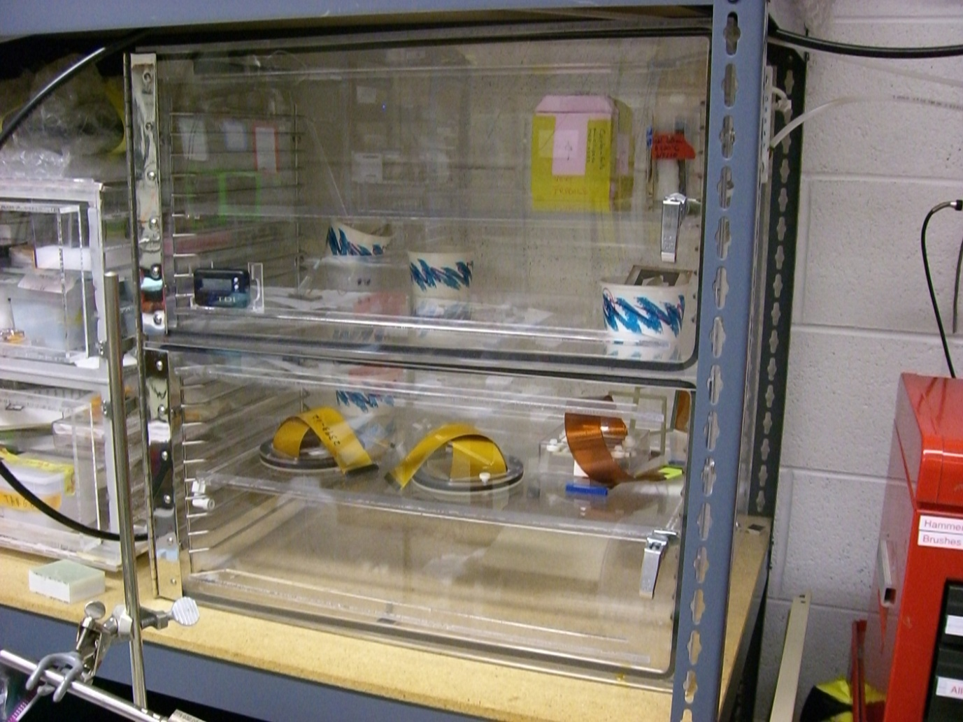
Purchasing
Wire rack; 24” x 24” x 74”, $140
Wire rack; 24” x 36” x 74”, $216.5
Desiccator; TDI 2 Door, 24” x 18” x 24”, quote requested.
Shelves on the southern wall.
Tools; Phillips drivers, level, drill/driver kit …
Desiccator in the Hira lab
DeWALT DC720KA $219.00

Slide 5
Milestone dates
Cathode voltage supply delivered | 5/25/2010
Test room complete | 4/30/2010
Main chamber complete | 6/28/2010
End plate complete | 7/15/2010
Field cage/voltage divider circuit complete | 7/22/2010
Cathode complete | 7/29/2010
Isolator beam duct complete | 8/5/2010
Cathode feed thru complete | 8/13/2010
Bellows for length adjustment complete | 8/20/2010
Corona ring complete | 7/30/2010
Chamber stand complete | 8/26/2010
Electric field simulation complete | 3/18/2010
Micromegas delivered from CEA-Saclay, France | 7/19/2010
Assembly of all components complete | 8/23/2010
No leakage in field cage confirmed | 8/25/2010
Cathode voltage tested to 50 kV | 9/3/2010
Remote control of cathode voltage complete | 9/8/2010
SAD complete | ?
Testing - field gradient agrees w/simulation | 9/29/2010
Scheduled finish | 9/29/2010

