Slide 1
Velocity of electron drift in He/Ar-based gases
June 11, 2010
Daisuke SUZUKI, NSCL

Slide 2
Simulation information
Calculated by the Monte-Carlo code Magboltz
Reference; S. F. Biagi, NIM A421, 234 (1999)
Code distribution; http://consult.cern.ch/writeup/magboltz
How to use; http://www.physics.carleton.ca/research/ilc/results2004/tpc_test/magboltz.html
T = 293 K, P = 760 Torr

Slide 3
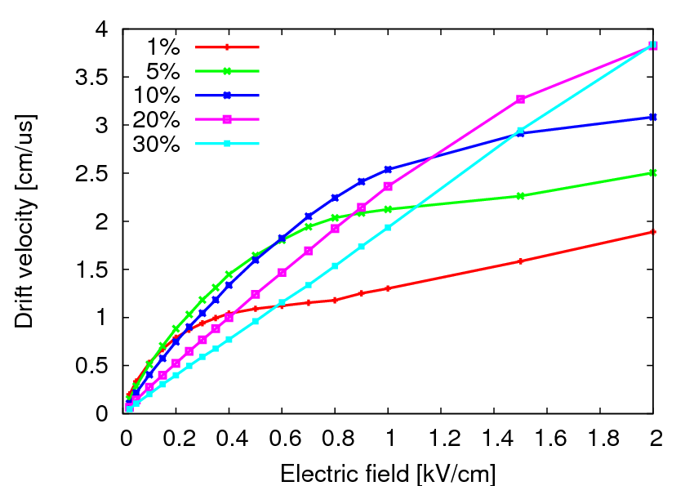
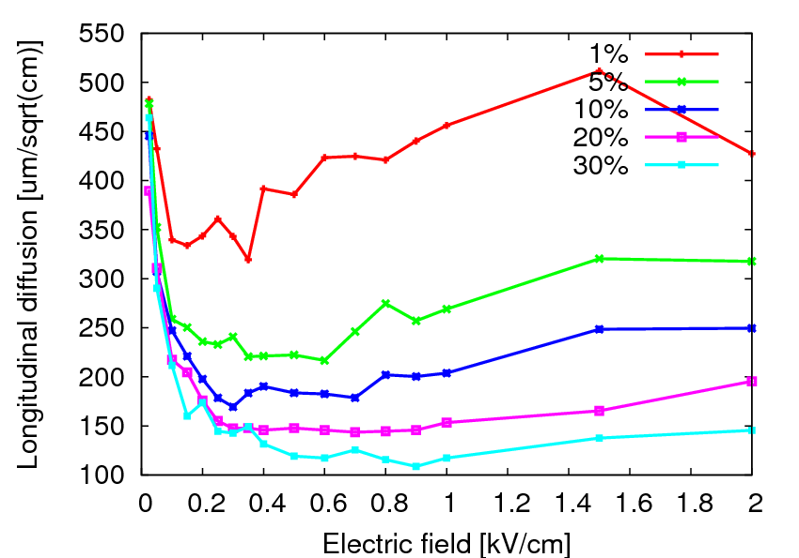
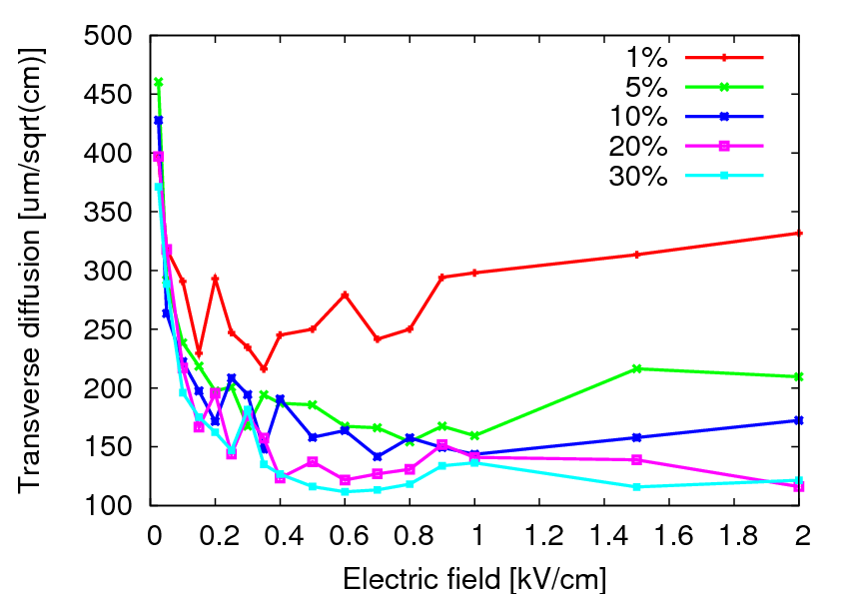
Electron drift in He + CO₂ gas
He + CO₂ 10%
Velocity;
2.5 cm/us for E = 1 kV/cm
Diffusion;
Longitudinal = 2 mm/100 cm
Transverse = 1.5 mm/100 cm

Slide 4
Drift velocity in He + CO₂ gas
He + CO₂ 10%
Velocity;
2.5 cm/us for E = 1 kV/cm
Fluctuation;
Given dE = 1% -> dv = 0.6%
e.g. 3 mm for 500 mm drift
 | Nominal value | 1% precision
Field gradient | 1 kV/cm | 10 V/cm
Temperature | 300 K | 3 K
Pressure | 740 Torr | 7 Torr

Slide 5
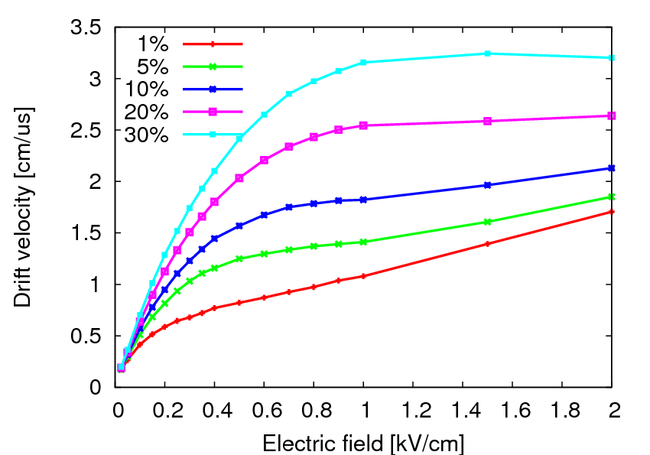
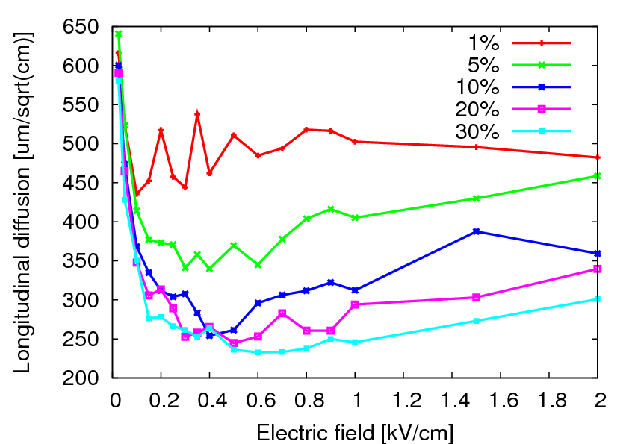
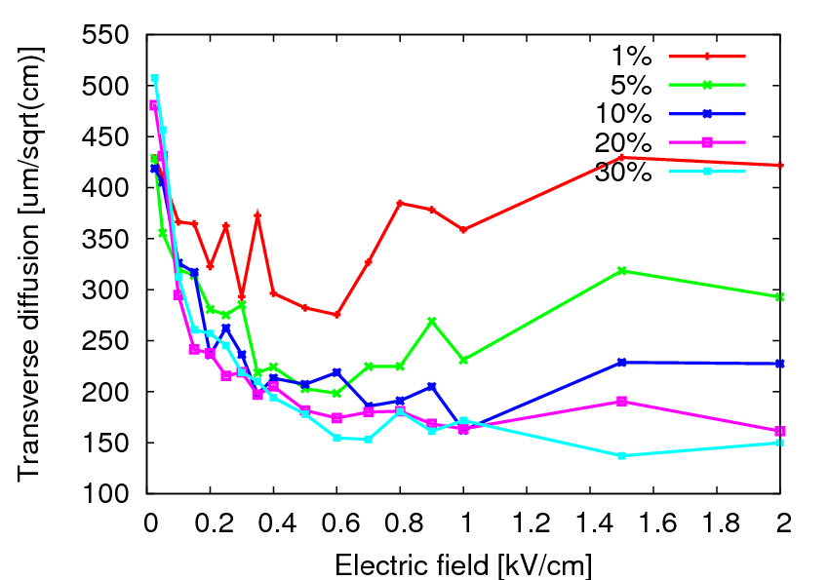
Electron drift in He + CH₄ gas
He + CH₄ 10%
Velocity;
1.8 cm/us for E = 1 kV/cm
Diffusion;
Longitudinal = 3 mm/100 cm
Transverse = 1.8 mm/100 cm

Slide 6
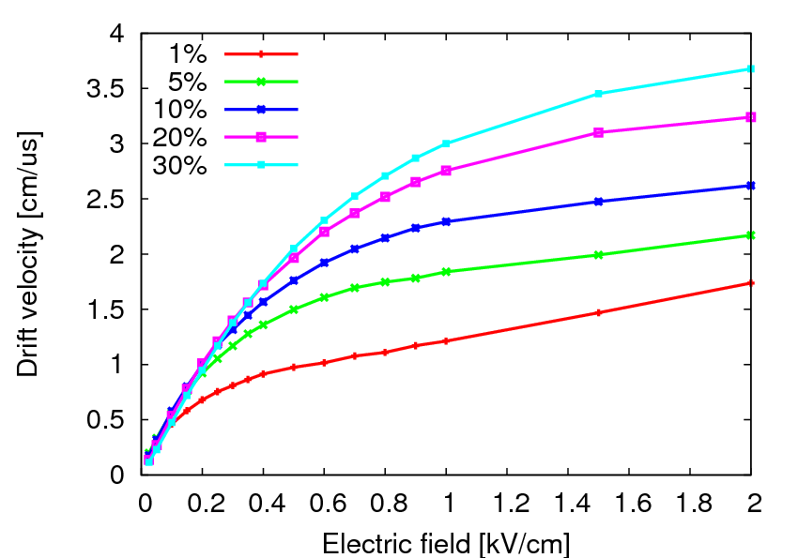
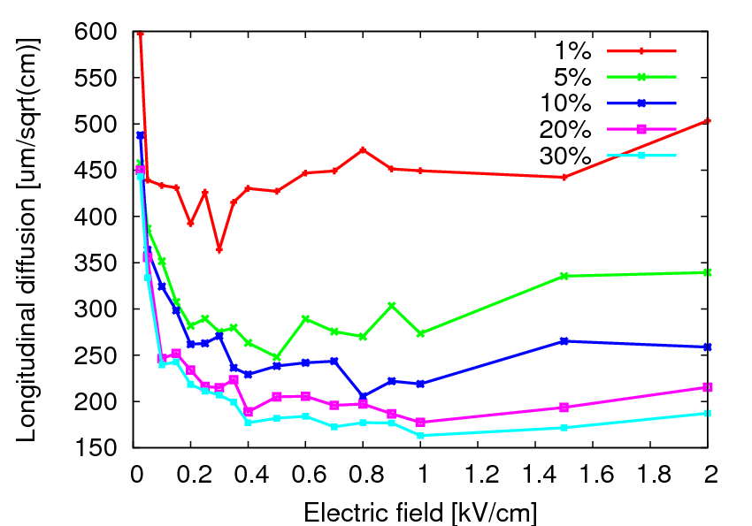
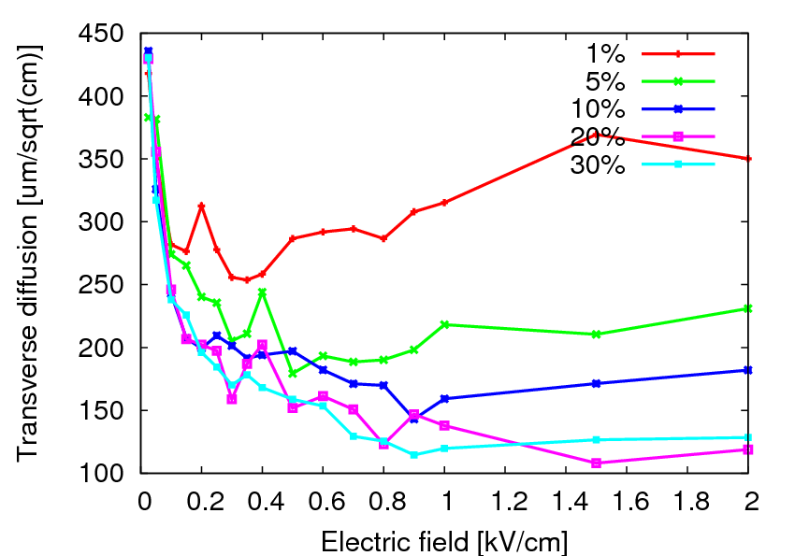
Electron drift in He + C₄H₁₀ gas
He + C₄ H₁₀ 10%
Velocity;
2.2 cm/us for E = 1 kV/cm
Diffusion;
Longitudinal = 2 mm/100 cm
Transverse = 1.5 mm/100 cm

Slide 7
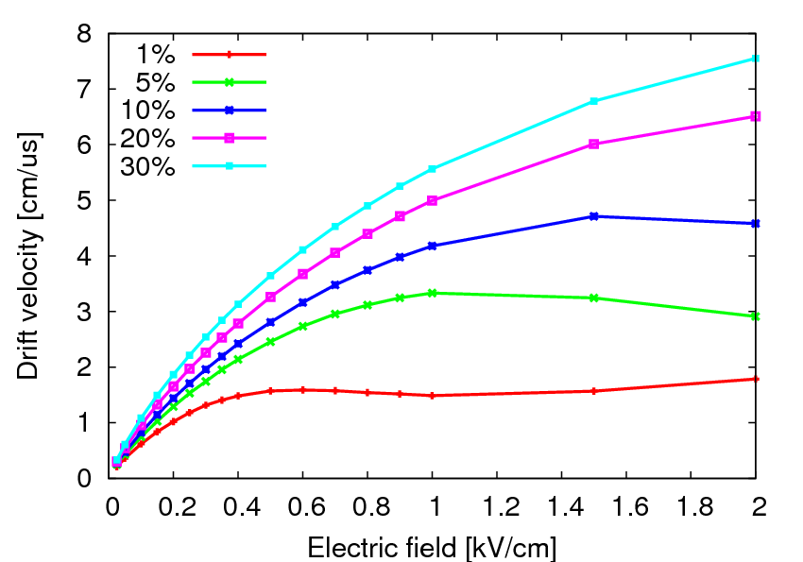
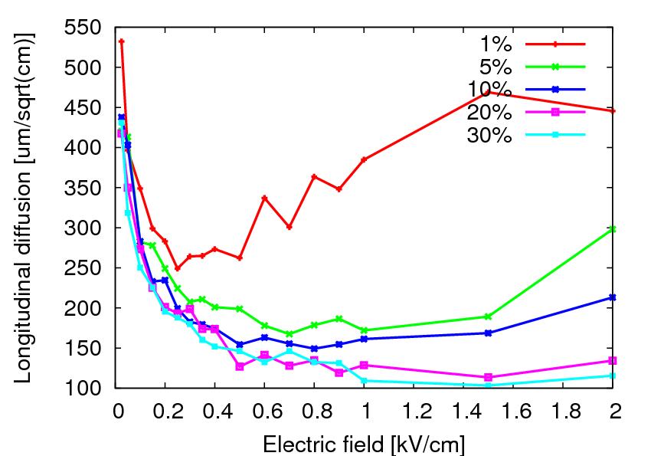
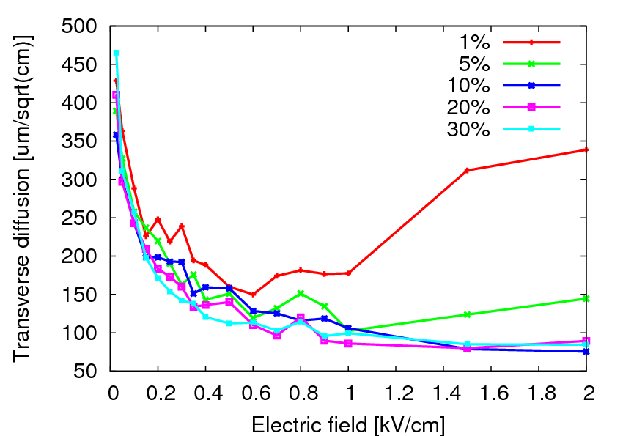
Electron drift in He + CF₄ gas
He + CF₄ 10%
Velocity;
4 cm/us for E = 1 kV/cm
Diffusion;
Longitudinal = 1.5 mm/100 cm
Transverse = 1 mm/100 cm

Slide 8
Summary
 |  | 10% CO₂ | 10% CH₂ | 10% C₄H₁₀ | 10% CF₄
Density [mg/cm³] |  | 0.333 | 0.216 | 0.391 | 0.516
Range [mm] for ⁸He @ 16 MeV |  | 488 | 612 | 342 | 350
E = 1 kV/cm | v [cm/um] | 2.54 | 1.82 | 2.29 | 4.18
 | Diffusion L [mm] @ 100cm | 2.0 | 3.0 | 2.2 | 1.5
 | Diffusion T[mm] @ 100cm | 1.5 | 1.7 | 1.5 | 1.2
 | dv/v [%] for dE/E = 1% | 0.5% | 0.05% | 0.25% | 0.5%
E = 0.5 kV/cm | v [cm/um] | 1.60 | 1.57 | 1.76 | 2.81
 | Diffusion L [mm] @ 100cm | 2.0 | 2.5 | 2.3 | 1.5
 | Diffusion T[mm] @ 100cm | 1.5 | 2.0 | 2.0 | 1.5
 | dv/v [%] for dE/E = 1% | 1.6% | 0.8% | 1.1% | 1.4%
E = 0.3 kV/cm | v [cm/um] | 1.05 | 1.23 | 1.32 | 2.00
 | Diffusion L [mm] @ 100cm | 1.7 | 3.0 | 2.5 | 1.8
 | Diffusion T[mm] @ 100cm | 2.0 | 2.5 | 2.0 | 2.0
 | dv/v [%] for dE/E = 1% | 1.4% | 1.0% | 1.1% | 1.3%

Slide 9
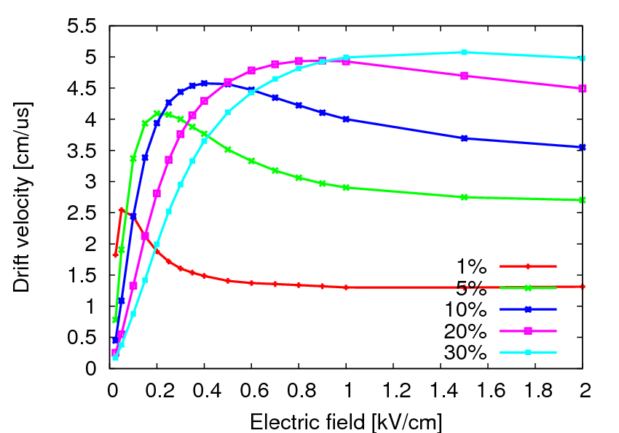
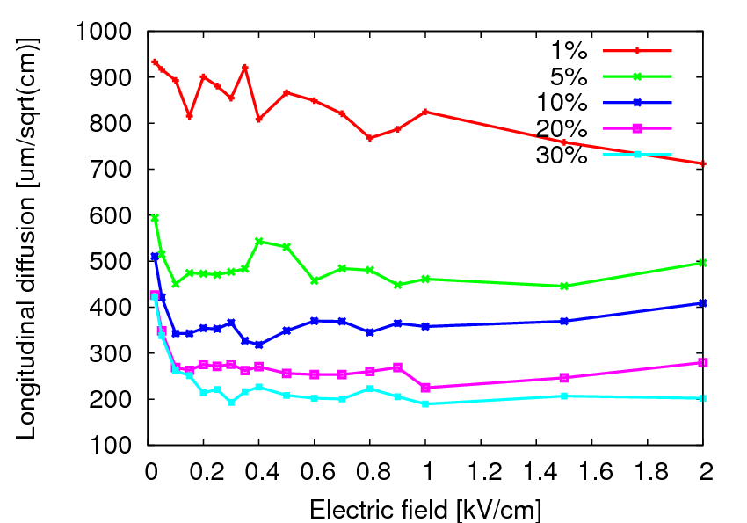
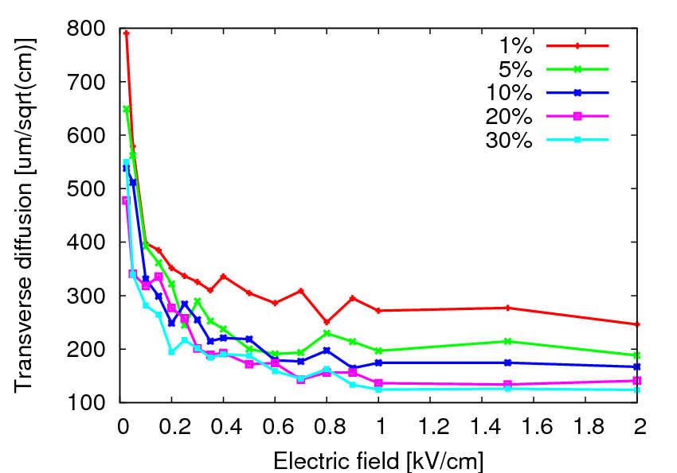
Electron drift in Ar + C₄H₁₀ gas
Ar + C₄H₁₀ 10%
Velocity;
4 cm/us for E = 1 kV/cm
Diffusion;
Longitudinal = 3.5 mm/100 cm
Transverse = 1.5 mm/100 cm

