Slide 1
Update of Prototype AT-TPC
May 6, 2010
Weekly meeting
Daisuke Suzuki, NSCL

Slide 2
Test room update
Completed
Construction
Clean room certification (class 1,000)
On-going
Pump exhaust connection
Room key -> NSCL standard UB-4
To do
Utilities
Gas bottle stand installation (10 min job)
Ethernet (Office, clean DAQ, control requested)
Clean AC supply, clean DAQ network (2~3 months)
Entrance space (work order needed)
Accessories
Clean room cloths
Stool, chair -> MSU surplus, local warehouse

Slide 3
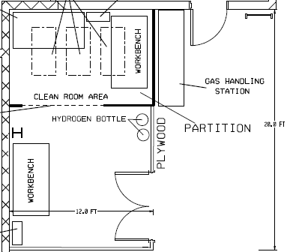
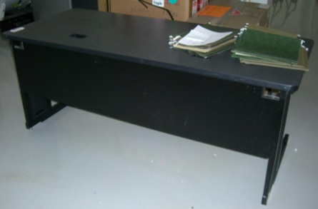
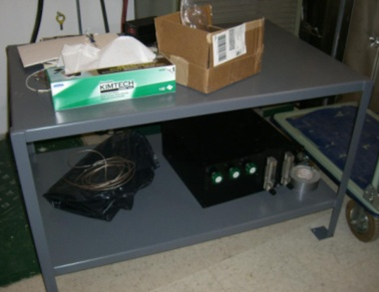
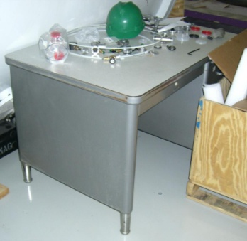
Layout plan
12 ft
Scale = 40”/1”
Desk 04
Cabinet 2
Desk 01
Desk 05
97”
21”1/4
47”3/4
21.5”
Desk 03
12”
45.5”
118.5”
Desk 02
Rack
Utilities
77.5”
Gas handler
Gas bottle
Tool box
17”

Slide 4
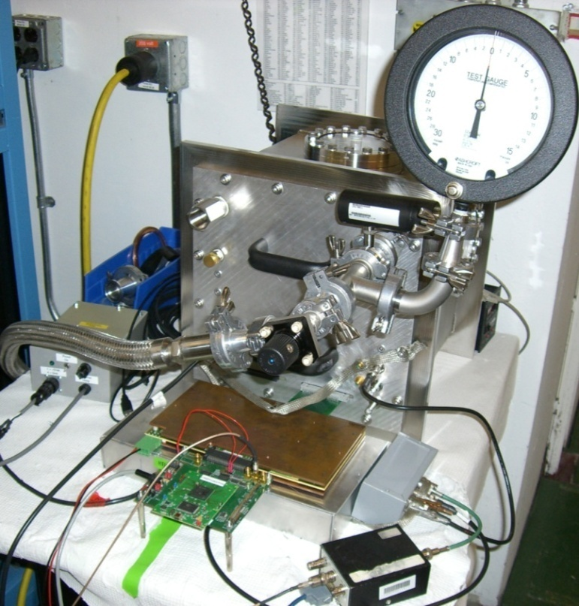
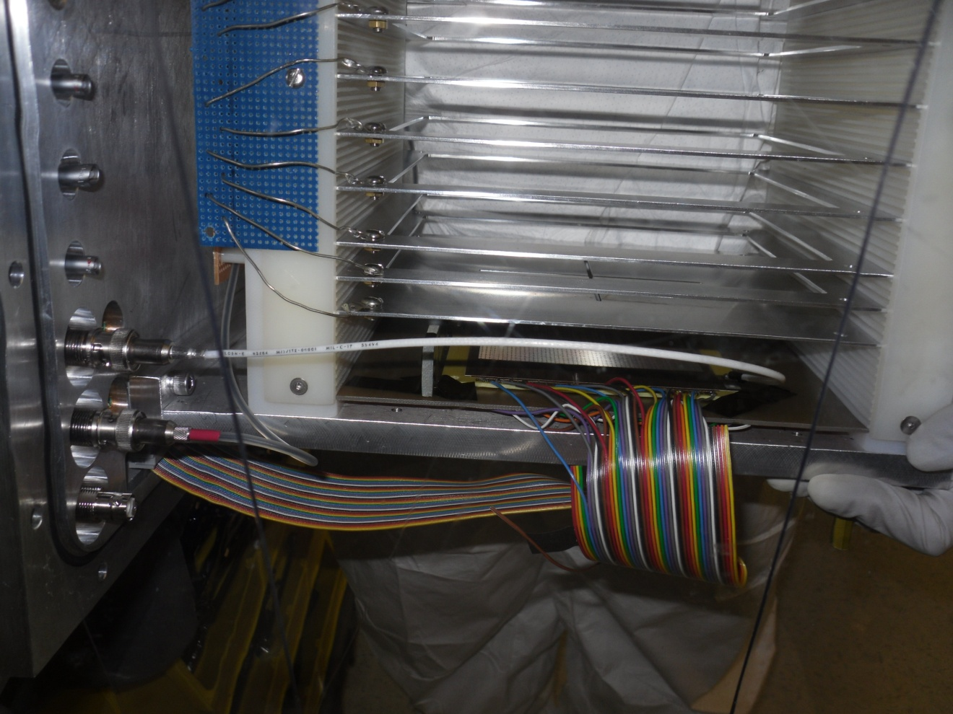
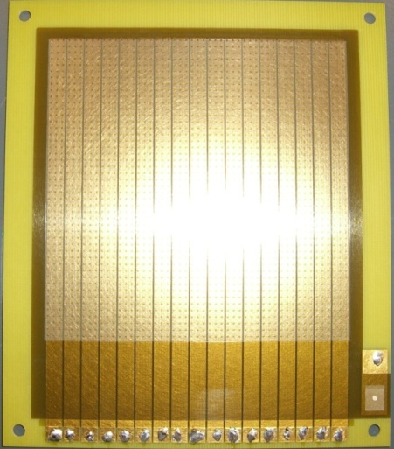
Test at the test bench; setup
He + CO₂ (10%) 1 atm, ²⁴¹Am
Cathode
α
10 x 10 cm²
w/ 17 strips

Slide 5
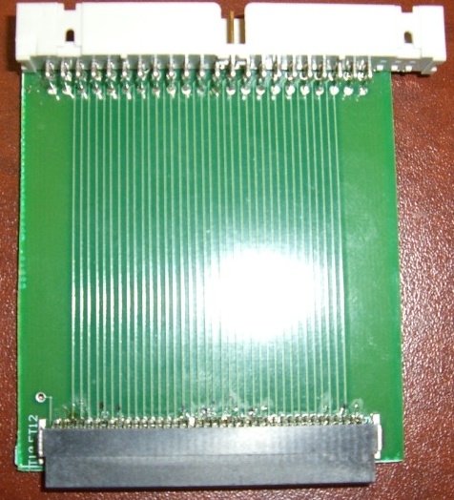
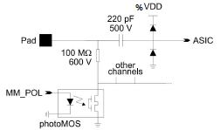
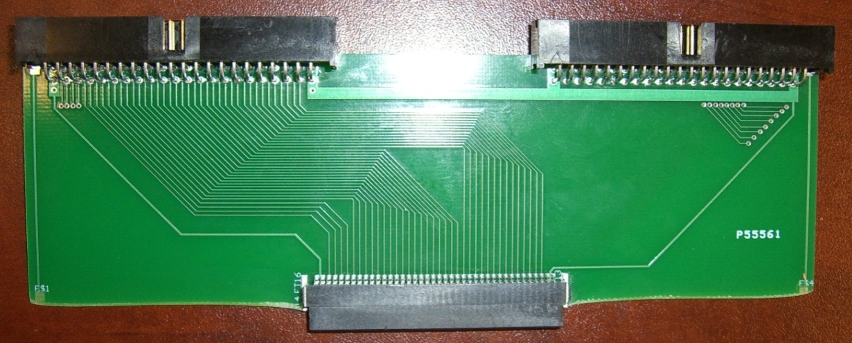
New adopter board
Mesh signal amplitude was very small.
The adopter board and the T2K was not fully connected. The anode pads floated.
Part of the PCB was cut off to improve the connection.
V_{mesh} = -350 V, V_{cathode} = - 1~2 kV; A_{mesh} = - 60 mV (old) <-> -50 mV (new)
Measured the resistance from the adopter input to the T2K ground
Old 100 M Ω <-> New > 1 GΩ
Old
Adopter
New

Slide 6
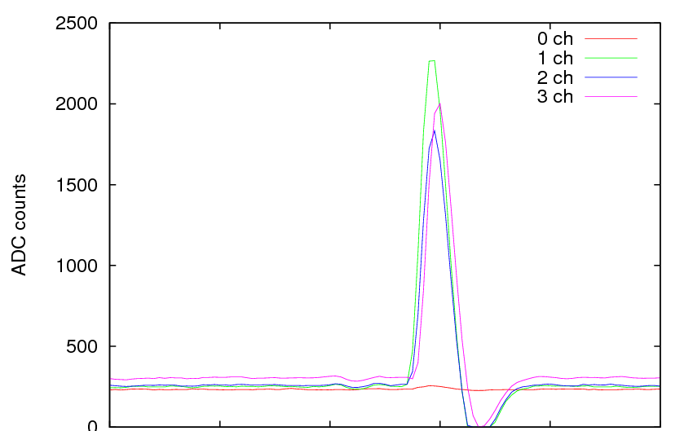
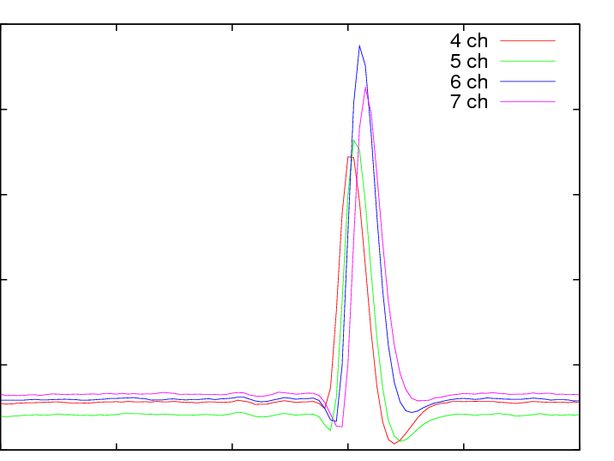
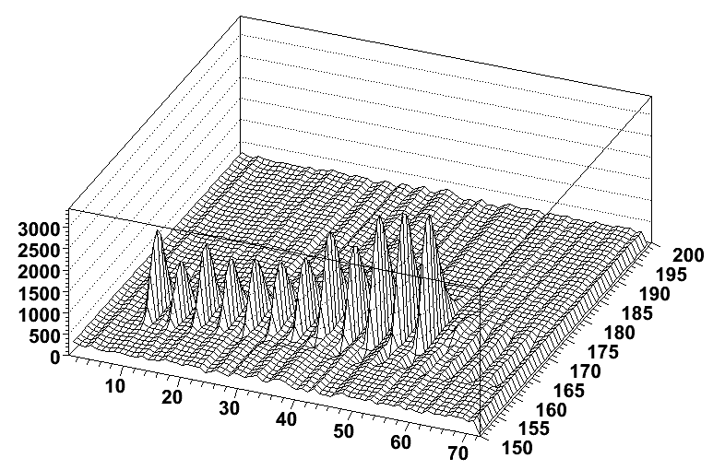
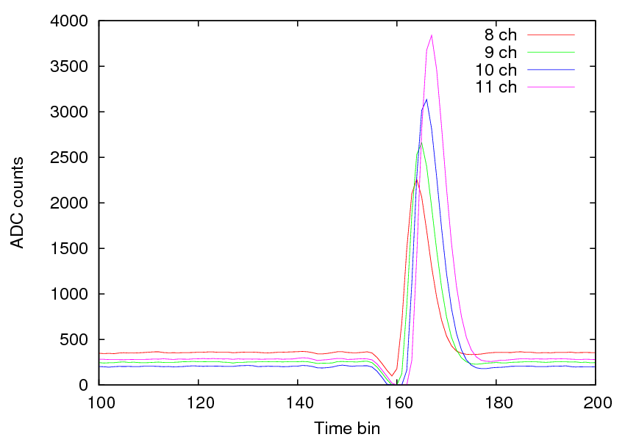
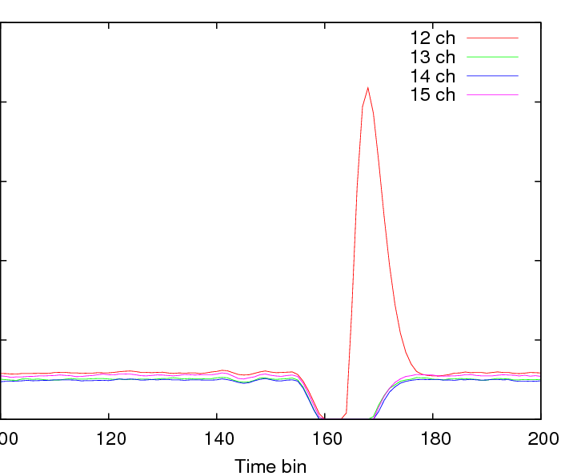
Negative cross talk
Run 202 He+CO₂(30%) 1 atm, ²⁴¹Am
Event 3
α
Time bin
ASIC Channel
Cross talk signal with negative polarity
Almost identical amplitude

Slide 7
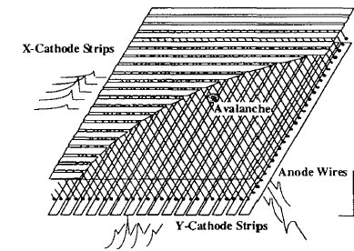
Measure
Wire plane
F. Sauli, CERN/94-195, 1994
Micromegas
mesh
0.1 mm
pad
0.5 mm
Pads are coupled by the mesh.
-> C_{pad} is independent on the distance between the associated pads
Capacitive coupling among the anode pads
Amplitude ~ C_{pad}/C_{tot}
High segmentation
-> Low C_{pad}/C_{tot}
Put a capacitor between the mesh and the ground
<-> Damage risk during discharge
STAR TPC NIM A499, 659 (2003)

Slide 8
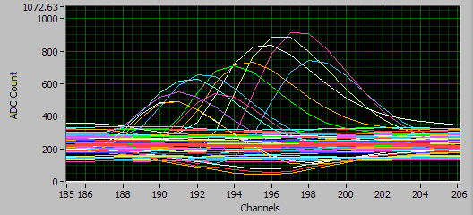
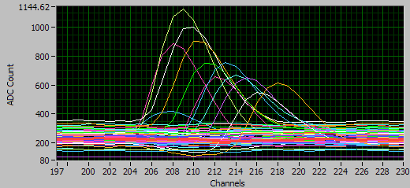
Result
mesh
c.f. Measured capacitance of Micromegas C_{tot} = 1.1~1.4 nF
C_{add}
pad
C_{add} = 0
C_{add} = 2 nF
The negative pulse amplitude reduced by factor of ~3

