Slide 1
Update of Prototype AT-TPC
June 17, 2010
Weekly meeting
Claire Hewko, NSCL

Slide 2
Overview
Go to a charge resolution from 15% to 2%
Charge resolution after changing with gas of high purity
Dependence of charge resolution with the cathode and mesh voltage
The source of noise in the charge specter
Collimator problem?
Helium problem?
Sparking problem?

Slide 3
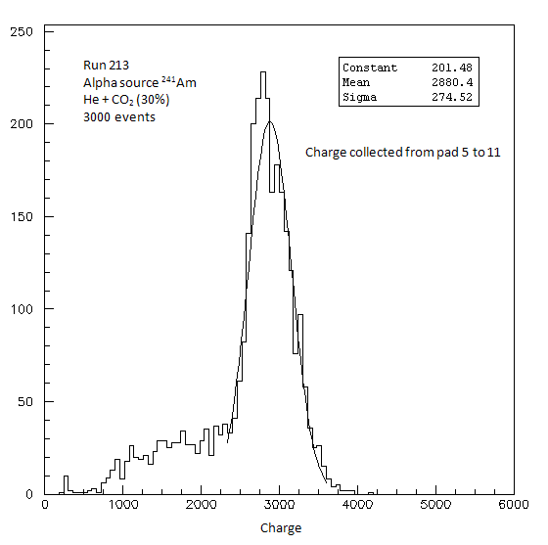
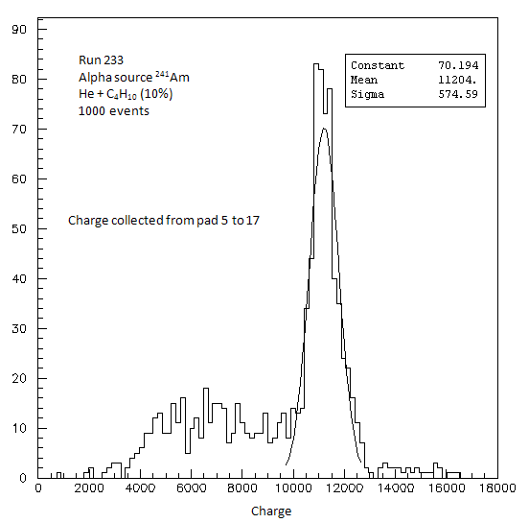
Charge resolution after changing with gas of high purity
9% resolution
15% real resolution
2.5% resolution
A part of the low resolution seems coming from the impurity in the gas, even if the real resolution should be upper than 2.5%

Slide 4
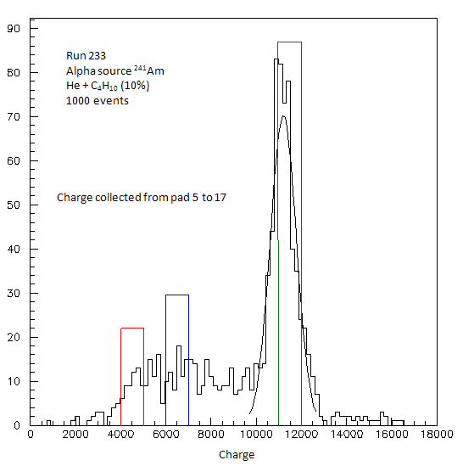
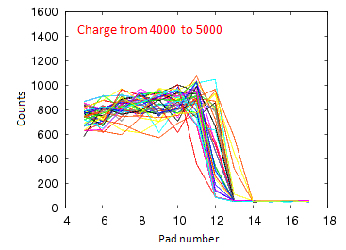
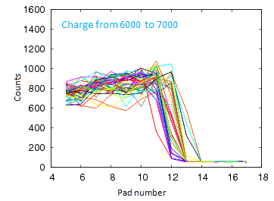
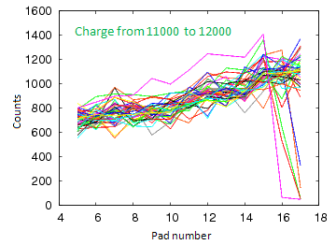
The source of noise in the specter of charge

Slide 5
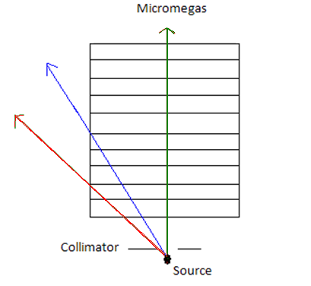
Where does the noise come from: collimator?
It should imply a delay in the collection of the charge on the pads of the green particle and the blue particle compare to the red one
Which order?
We have to look for!

Slide 6
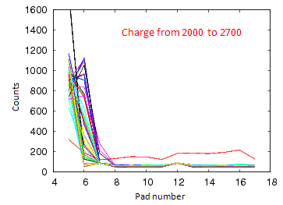
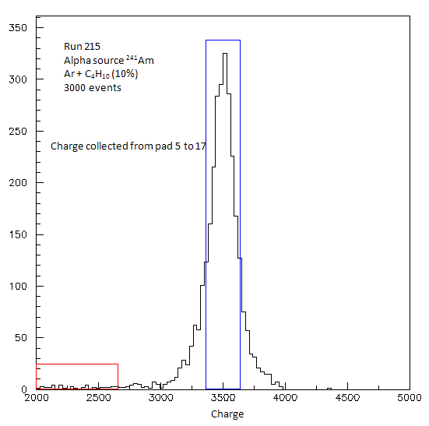
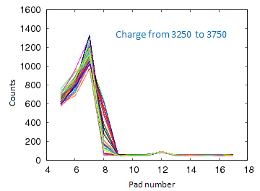
Where does the noise come from: helium?

Slide 7
Where does the noise come from: sparking?
Sparking
Sparking only from the pad 13 to 17 ??

