Slide 1
06 May 2010, AT-TPC meeting
Discussion about a laser calibration system

Slide 2
Laser calibration : why?
Monitor the drift velocity
Check the electrodes/pads
Calibrate the pads

Slide 3
Concept: CERES
Laser
All mirrors and optical
elements are fixed
except for a single
programmable rotating
mirror at the center of
the device.
Photodiodes monitor
Beam position

Slide 4
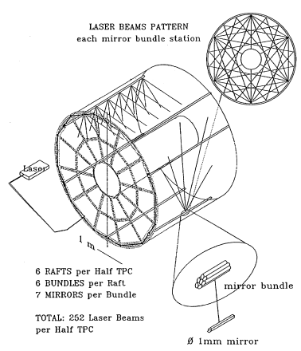
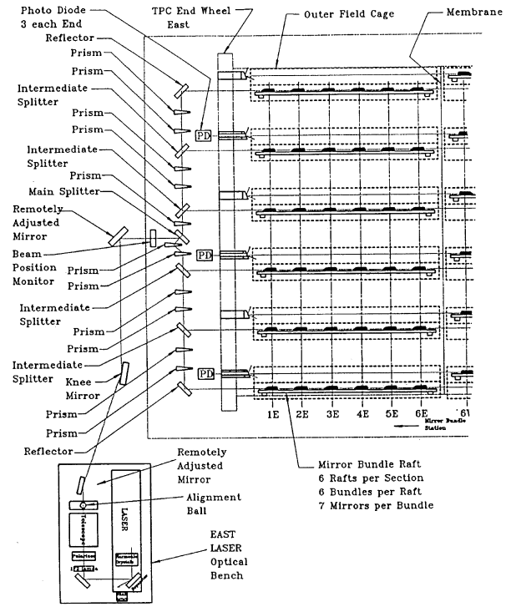
Concept: STAR
Multiple optical elements bring diffraction
into consideration. (Airy diffraction.)
Elaborate optical splitting and reflection system. Large aperture beam split
using small mirrors in beam path. Mirror bundles split and reflect beams along
multiple paths.

Slide 5
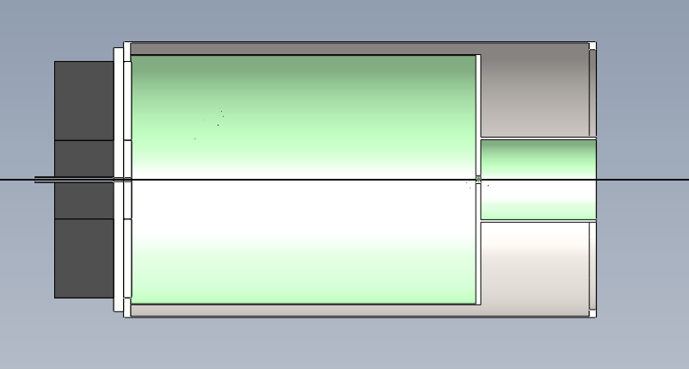
Basic monitoring of drift velocity 1
windows
LASER
e

Slide 6
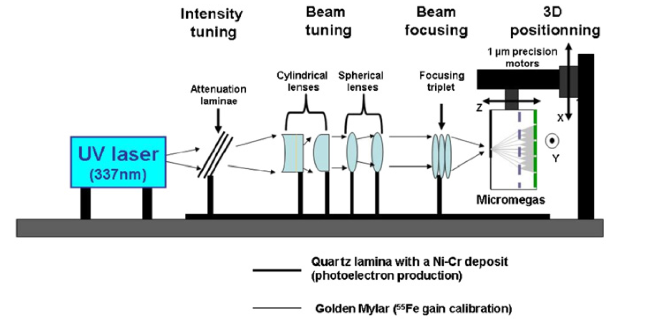
Basic monitoring of drift velocity 2
Based on NIM A 581 (2007) 258-260

Slide 7
Basic monitoring of drift velocity 2
Based on NIM A 581 (2007) 258-260
Quartz lamina with a thin metal layer deposit
Aluminized Mylar
window
Or
e
LASER

