Slide 1
Update of Prototype AT-TPC
April 29, 2010
Weekly meeting
Daisuke Suzuki, NSCL

Slide 2
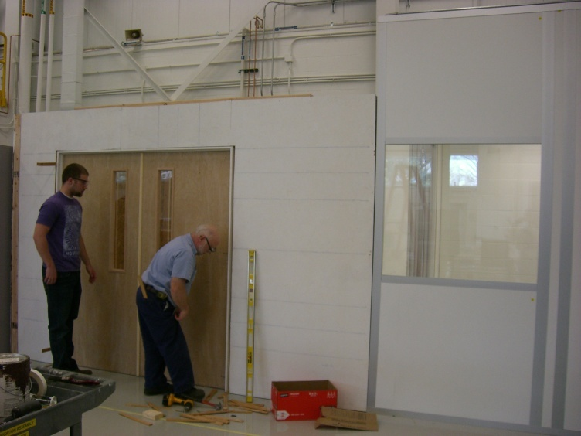
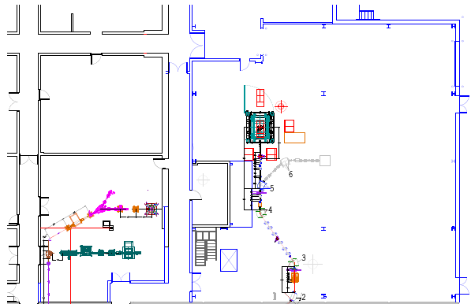
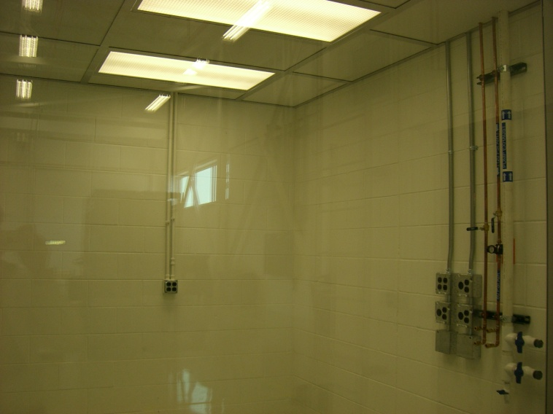
New test room update
New test room
ReA3
Clean room
Drawing by P. Zeller
The room completed.
Certification done (very low particle counts)
Moving will be in the next week

Slide 3
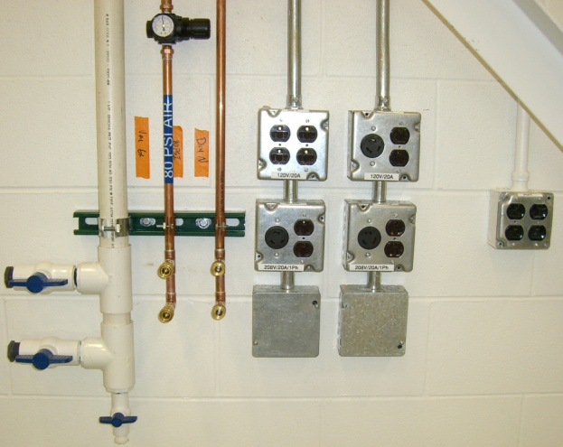
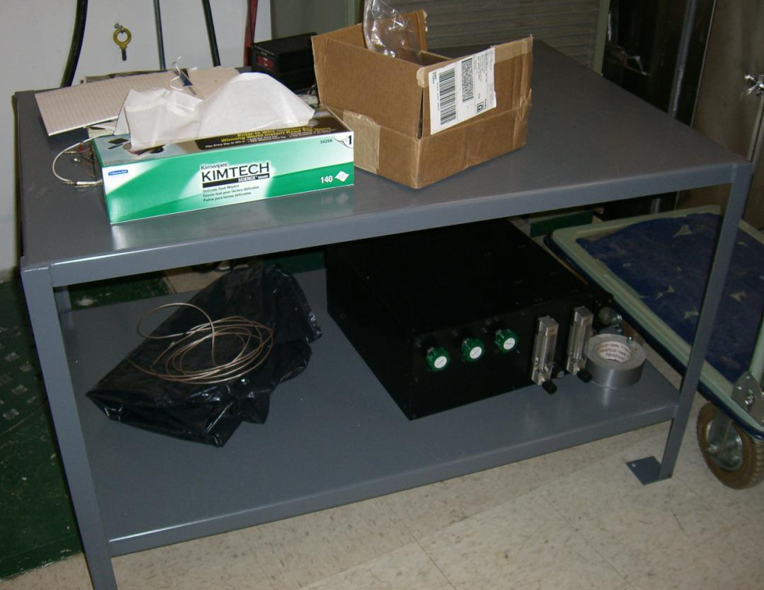
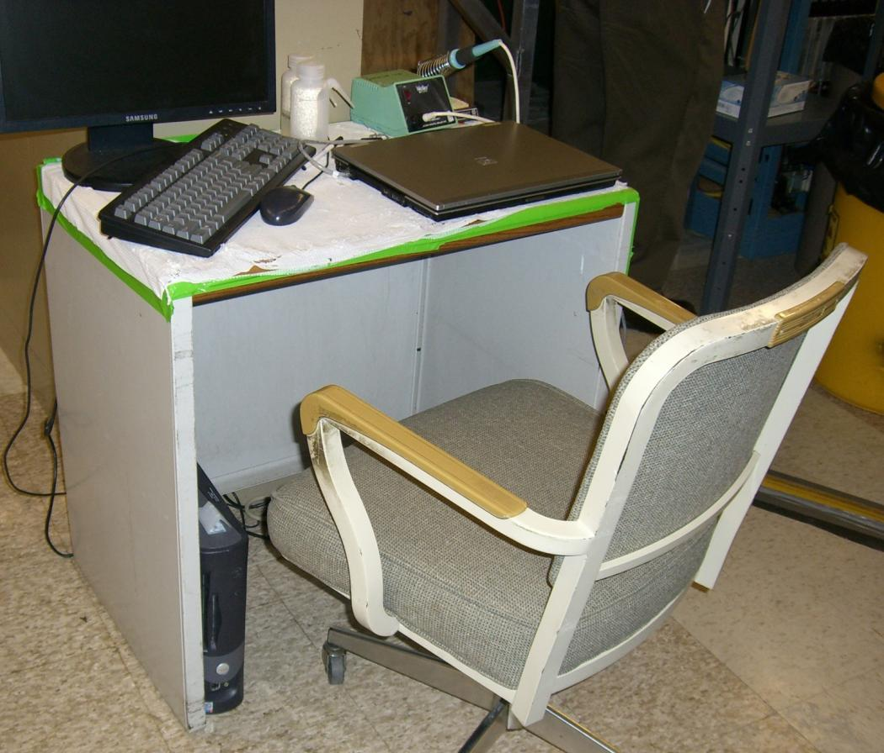
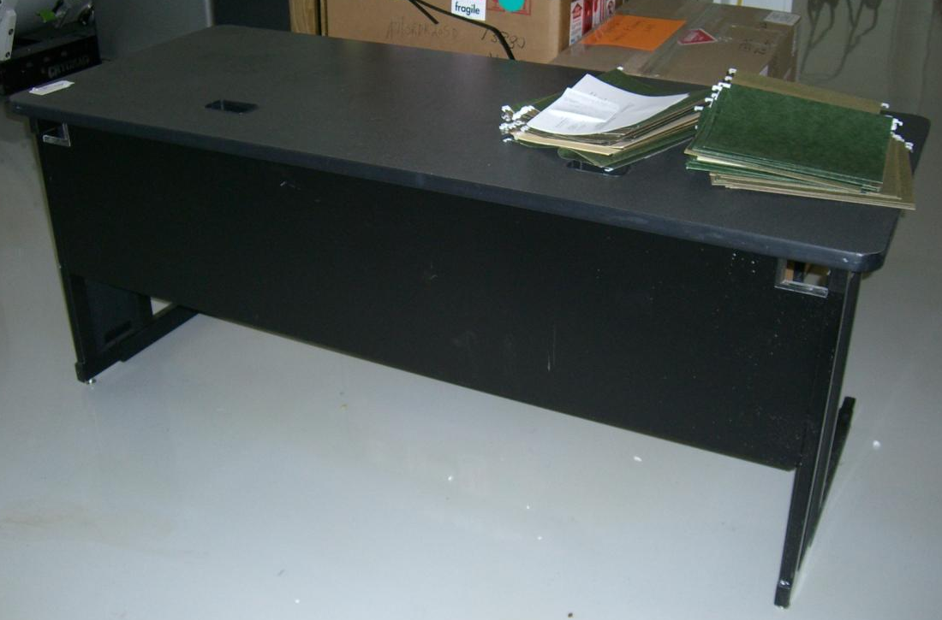
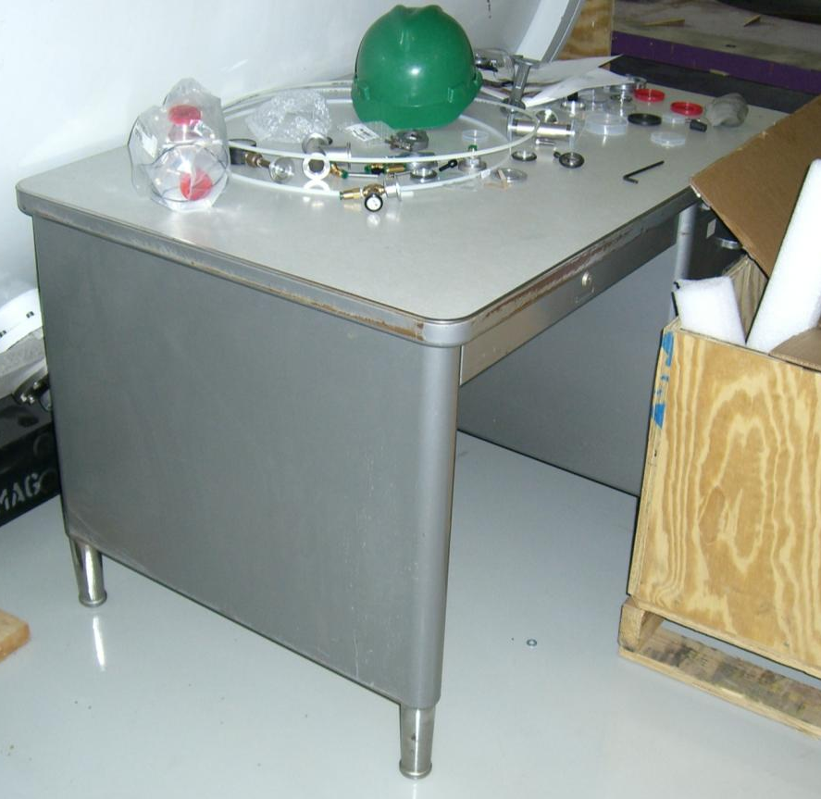
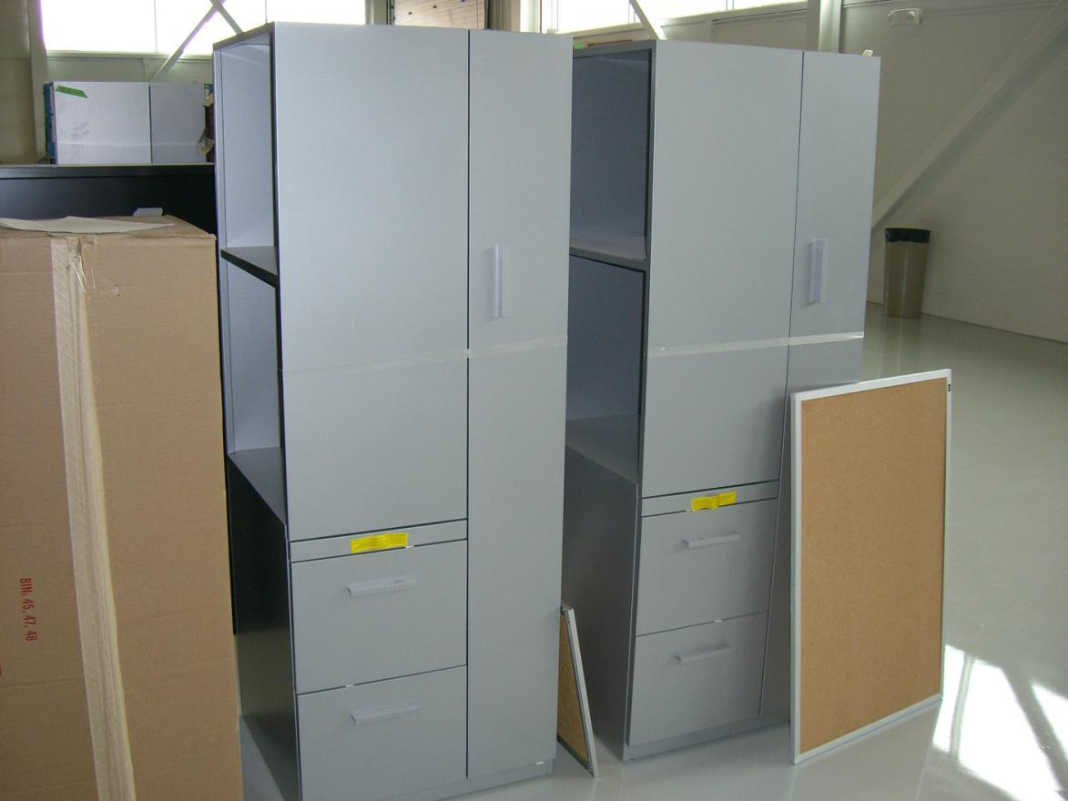
Clean room utilities & accessories
Ready
120/208 V AC, Compressed air 80 psi
4 Desks, 1 cabinet
Not ready
Utilities
Exhaust (Apr. 30), Dry N₂ (Unknown)
Ethernet (Under discussion)
Clean AC supply
Entrance space of the clean room (separate work order)
Accessories
Chair
Clean clothes, shoes, masks, gloves
Gas bottle stands (P. Zeller can get one)

Slide 4
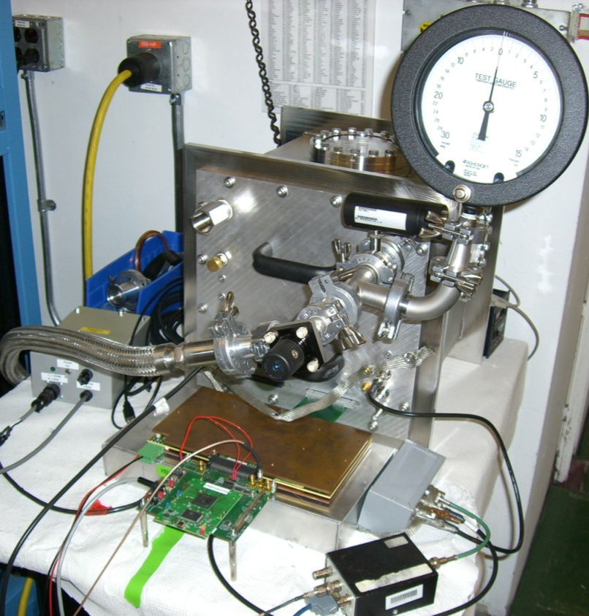
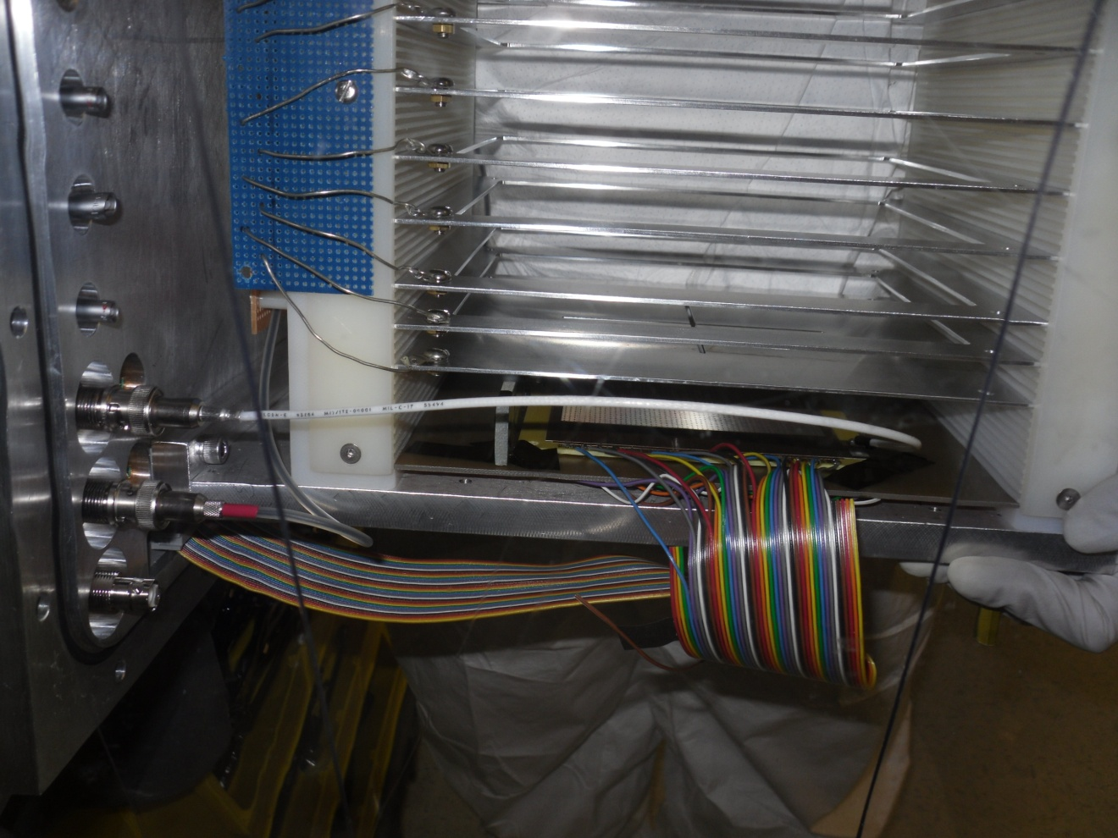
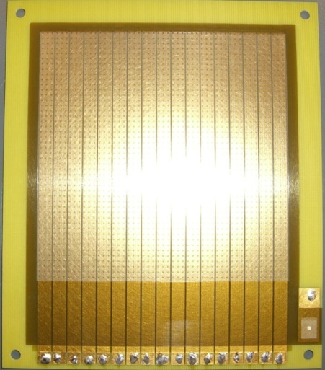
Test at the test bench; setup
He + CO₂ (10%) 1 atm, ²⁴¹Am
Cathode
α
10 x 10 cm²
w/ 17 strips

Slide 5
Test at the test bench
System check w/ the previous setup
Measured gain was consistent with the previous result.
New adopter board
Mesh signal amplitude was very small.
The connection between the adopter board and the T2K was incomplete. The anode pads floated.
Part of the PCB was cut off to improve the connection.
V_{mesh} = -350 V, V_{cathode} = - 1~2 kV
A_{mesh} = - 60 mV (old) <-> -50 mV (new)

