Slide 1
Update of Prototype AT-TPC
April 1, 2010
Weekly meeting
Daisuke Suzuki, NSCL

Slide 2
Project management
Preliminary Project Plan; In March
Kick-off meeting; March 25, 2010
Project Plan published; March 29, 2010
I:\departments\projectmanagement\Projects\AT-TPC\prototype
pSAD; In review
Planning Estimates-P4; Undertaken

Slide 3
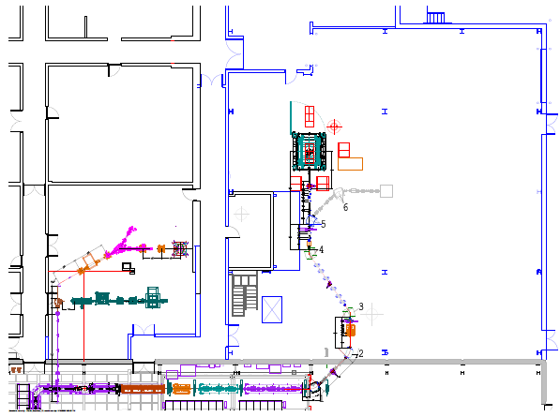
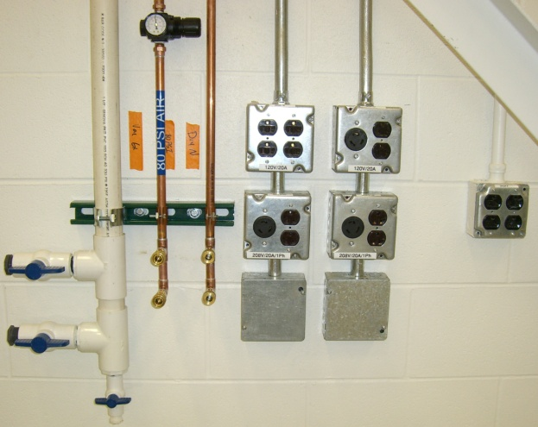
New test room update
New test room
Clean room
Drawing by P. Zeller
ReA3
Utilities (120/208 V AC, Compressed Air, Dry N₂, Exhaust) complete
Clean room construction; April 5, 2010
Scroll pump (Edwards XDS10 No gas ballast); May 28, 2010

Slide 4
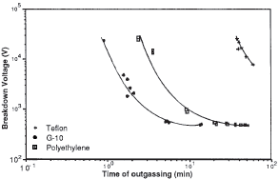
Material of field cage frame
Comment by Daniel
G10 is a source of outgas.
G10
Polyethylene
Teflon
R. G. Phillips et al., Electrical Insulation and Dielectric Phenomena, 1988. Annual Report (1988) 41.
High outgas
Alternatives
Glass
Laminate; e.g., G10-CR (Cryogenic Grade) by John Yurkon
G10-CR (Cryogenic Grade) is an electrical and mechanical grade of glass cloth laminate impregnated and cured with a non-brominated epoxy resin. G10-CR is used in applications were flame retardancy isn't an issue. G10-CR contains no halogens and can be used in nuclear and space applications such as satellites, requiring stringent temperature demands in sub-zero environments, have very little risk of fire. G-10-CR is an excellent choice when working with liquid nitrogen and cryo lab applications.

