Slide 1
Update of Prototype AT-TPC
May 13, 2010
Weekly meeting
Daisuke Suzuki, NSCL

Slide 2
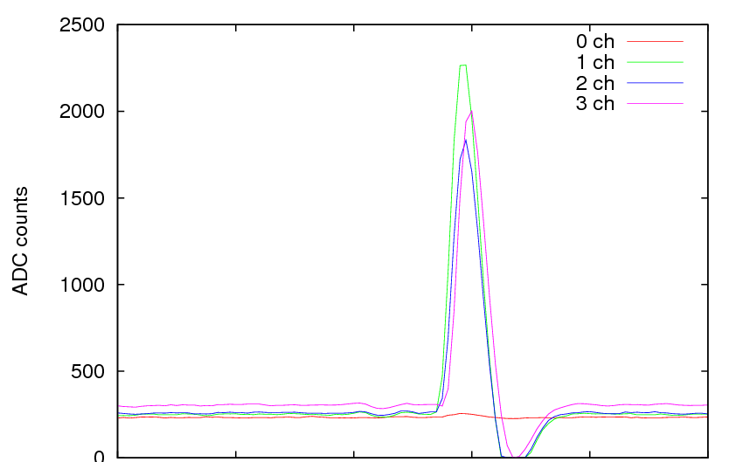
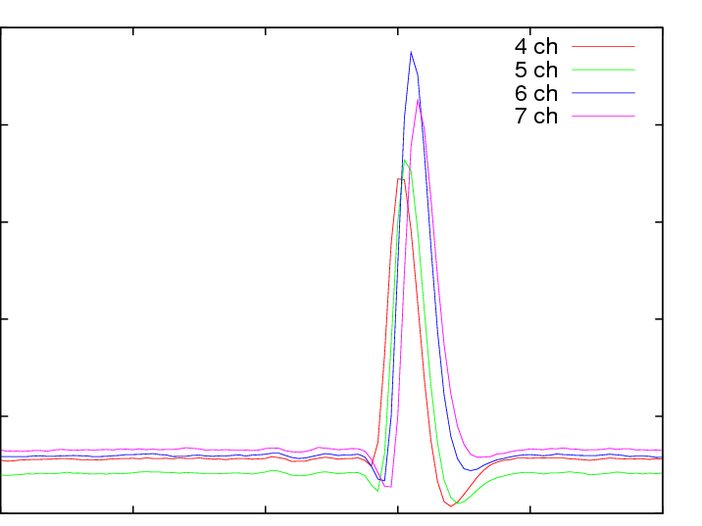
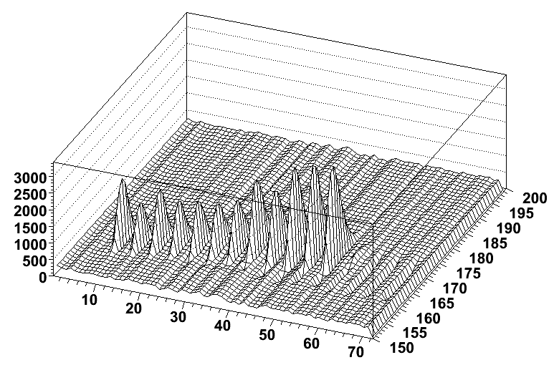
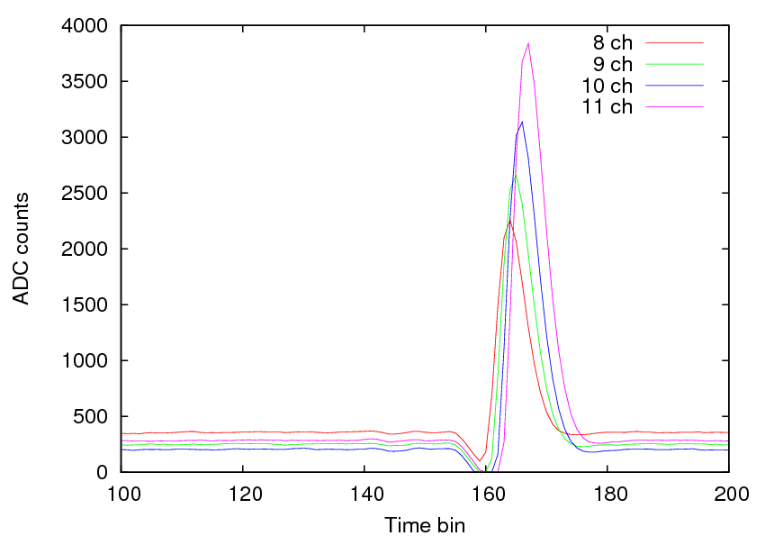
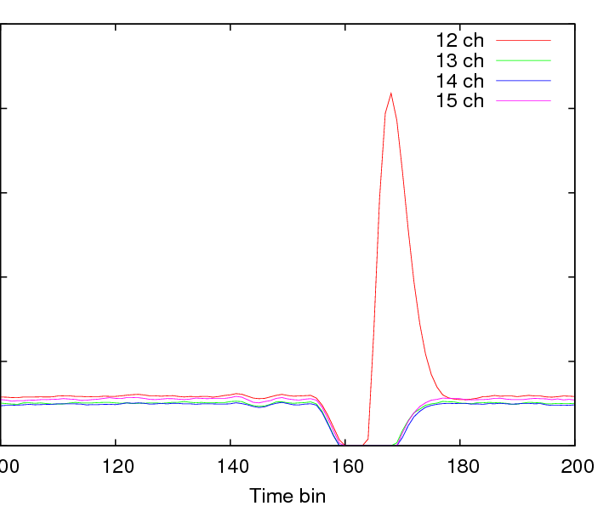
Negative cross talk
Run 202 He+CO₂(30%) 1 atm, ²⁴¹Am
Event 3
α
Time bin
ASIC Channel
Cross talk signal with negative polarity
Almost identical amplitude

Slide 3
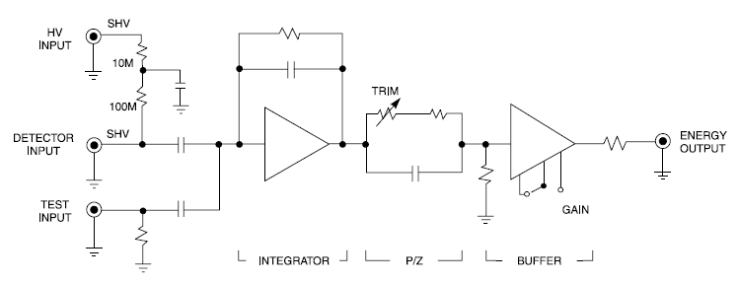
Result
mesh
R_{add}
16 nF
20 nF
pad
R_{add} -> smaller
Smaller cross talk
Larger noise
R_{add}
R_{add} = 0.5 kΩ
R_{add} = 50 MΩ
R_{add} = 10 MΩ
Negative cross talk reduced.
Noise level is still small.
R_{add} = 60 kΩ
No mesh signal observed.
R_{add} = 5 MΩ
R_{add} = 1 MΩ

