Slide 1
JINA-CEE Ion Optics Summer School
Michigan State University
Group_1_a_$α$_The First
(Isaac Yandow, Eun-Hun Lim, Thomas Ruland)
1 /19

Slide 2
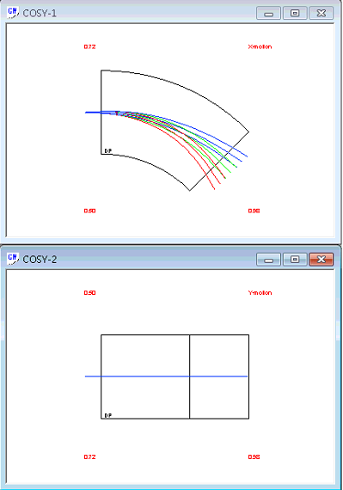
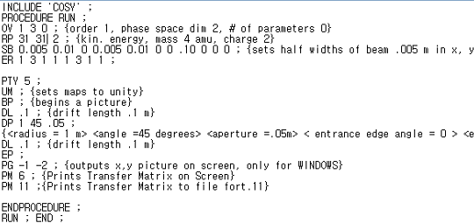
Team Project
The selected Reaction model is ${}_{}^{31}P(p,γ){}_{}^{32}S$.
The Energy of the outgoing sulfur is 31MeV
Horizontal
Vertical
Final x and y positions were determined to be x_f=.018 y_f=.009 at dE/E=.05

Slide 3
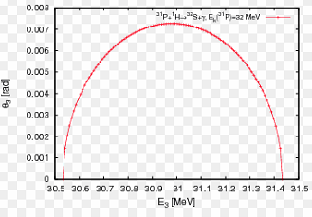
Team Project
energy spread is ~3.1%, the same as SECAR's 3.1% limit
opening angle is 7.0 mrad which is under the 25 mrad max of SECAR Our reaction has been performed before at much lower energies. (~1MeV total)

Slide 4
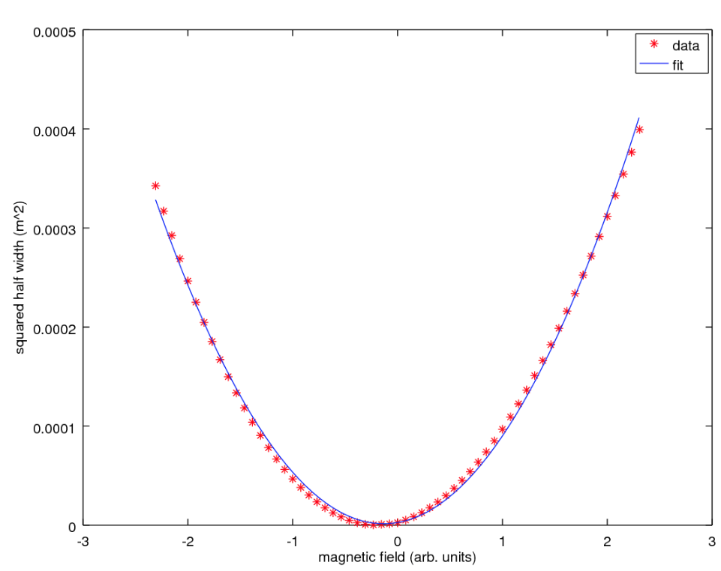
Team Project
Changing Quad Magnet, drawing g value-${Vmax}^{2}$ graph for finding $P_{1},P_{2},P_{3}$
Graph $y=P_{1}x^{2}+P_{2}x+P_{3}$
$$P_{1}=6.9103e−05$$
$$P_{2}=1.8340e−05$$
$$P_{3}=2.7010e−06$$
$$ε=0.80416 mm mrad$$

Slide 5
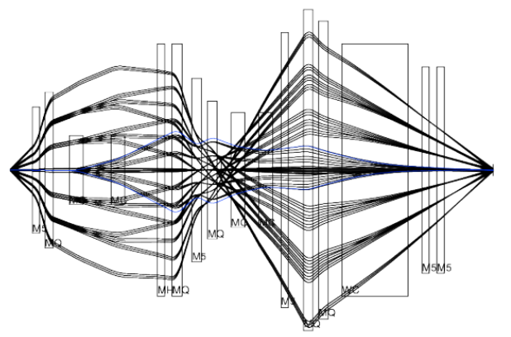
Team Project
Original mass resolving power of SECAR is 742.3138003312769(order 1)
Increase Q3 effective length 3% (0.3499->0.360397)
Also change DL7/DL8 (0.2648->0.2648015/0.34645->0.346515)
After changing mass resolving power of SECAR is 602.603…
And Recovery mass resolving power for using fitting Q3
OBJ:=1/ABS(Mass Resolution) + ABS(ME(1,2)/(XX))

Slide 6
Team Project
changing a variety of system parameters to see how much things can be changed before our mass resolution is changed by at least 5%.
BEAM SPOT:
X width: <.714286mm >.789414mm (~.04mm tolerance)
Y width: <.714286mm >.789414mm (~.04mm tolerance)
BEAM POSITION:
X tolerance: -2.346mm/+2.148mm
Y tolerance: -0.01166mmmm/+0.01168mm
QUADRUPOLE ALIGNMENT CHANGES:
Q3: Z Position change by +/- 1mm (~1mm tolerance)
X Position change by +/- .75mm Y Position change by +/- 8.45mm
Tilt Y change by +/-.0103 degree
Tilt X change by -.336 degree ~ +.303 degree

Slide 7
Stable Proton Capture: ³¹P(p,γ)³²S
Chosen randomly
Reaction occurs naturally in carbon rich shells of massive stars at the onset of a supernova [1]
Abundances of stable elements between²⁰Ne-³¹P are attributed to this carbon-shell (excluding ²⁸Si)
In 1975, the only one of these which hadn’t been predicted within a factor of two was P-31

Slide 8
Thank You
3 /19
1 /

