Slide 1
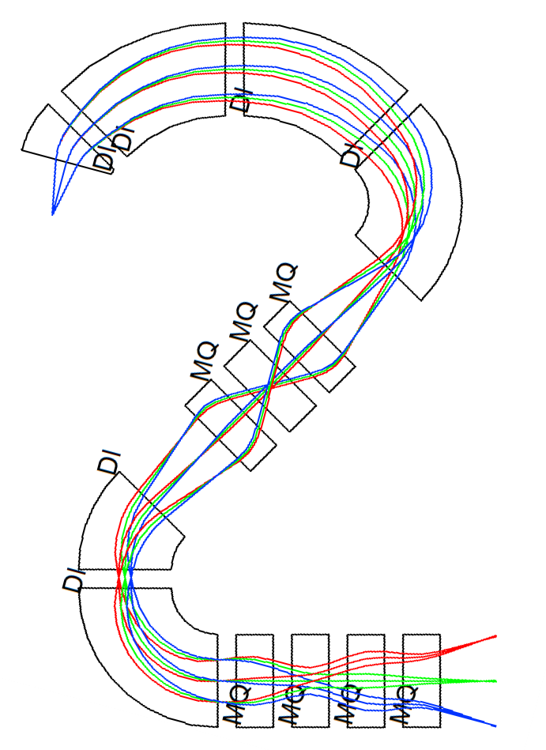
SECAR .0
Alex Plastun
Louis Wagner
Nadeesha Gamage
September 14, 2018

Slide 2
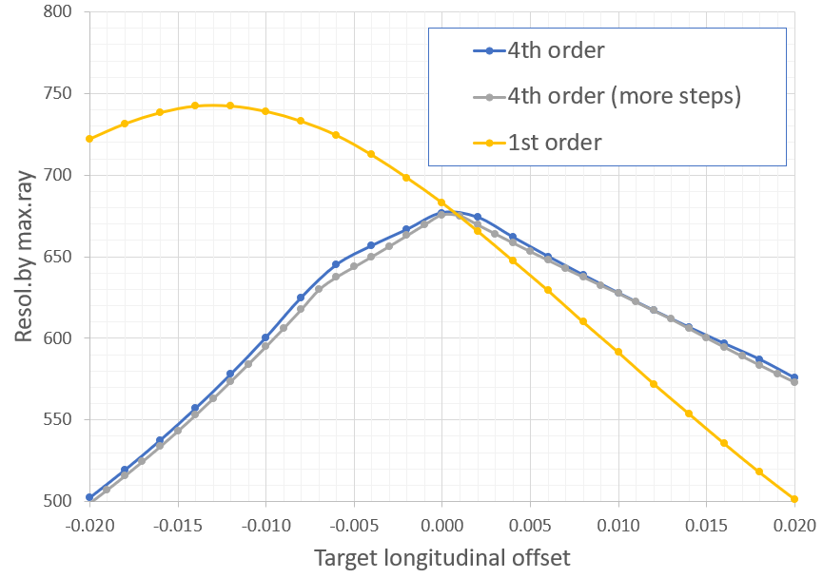
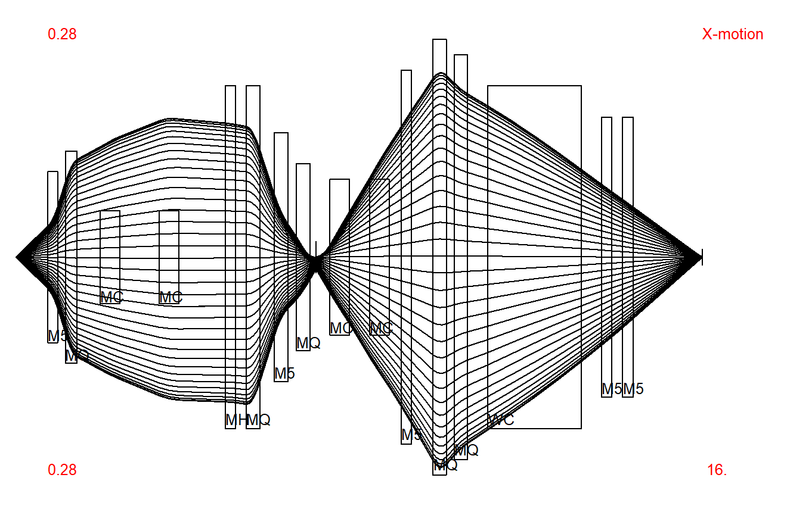
COSY is not an envelope or Monte-Carlo code.
For this reason all studies related with beam size measurements have an error, which depends on how well did you distribute the rays over the beam. In task #8 we observed non-smooth dependence of the resolution vs the target position.
We considered this as not very good distributed ray, so redistributed them over the border of the ellipse in Xθ-phase space.
But curve remained piece-wise until we reduced the order to the 1st.

Slide 3
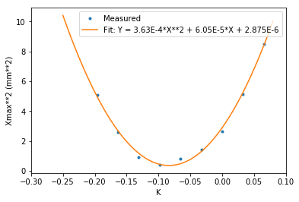
Emittance Measurement
Fit result for parabola
X_{max}² = σ₁₁ = a·K² - 2ab·K + ab² + c is:
a = 0.000362572706 b = 0.0834414129893 c = 3.506973286e-07
Consistency check
The consistency check for beam size calculation in Q7 shows: X_{calculated} = 3.13mm, X_{cosy_read_out} = 3.16mm at the Q7 exit. Emittance calculated from fit parameters $ε=\sqrt{ac}/L^{2}$ = 3.05E-7 π m rad = 0.305 π mm mrad. Start beam emittance= XX · AX= 0.2 π mm mrad, so the emittance grows from the start to the focal point. This emittance grow is possibly due to the optics aberrations. That is because the input COSY file does a 4th-order-calculation. Also the measured points don't fit the parabola ideally, i.e. the optics is non-linear.

Slide 4
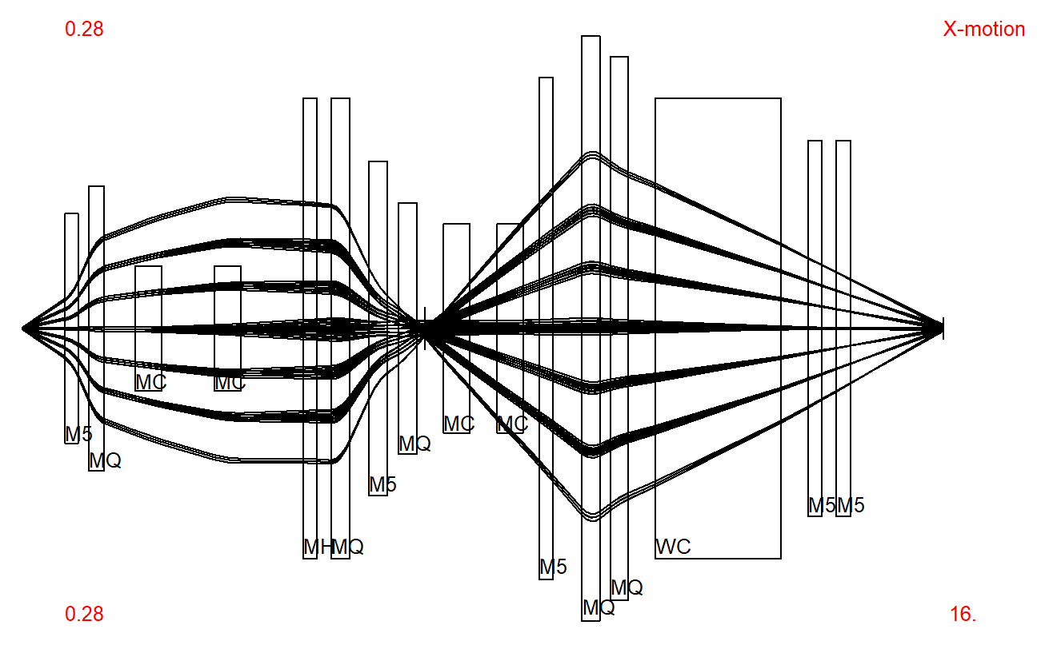
Recoil tracking
⁴⁵V+p → γ+⁴⁶Cr
?

Slide 5
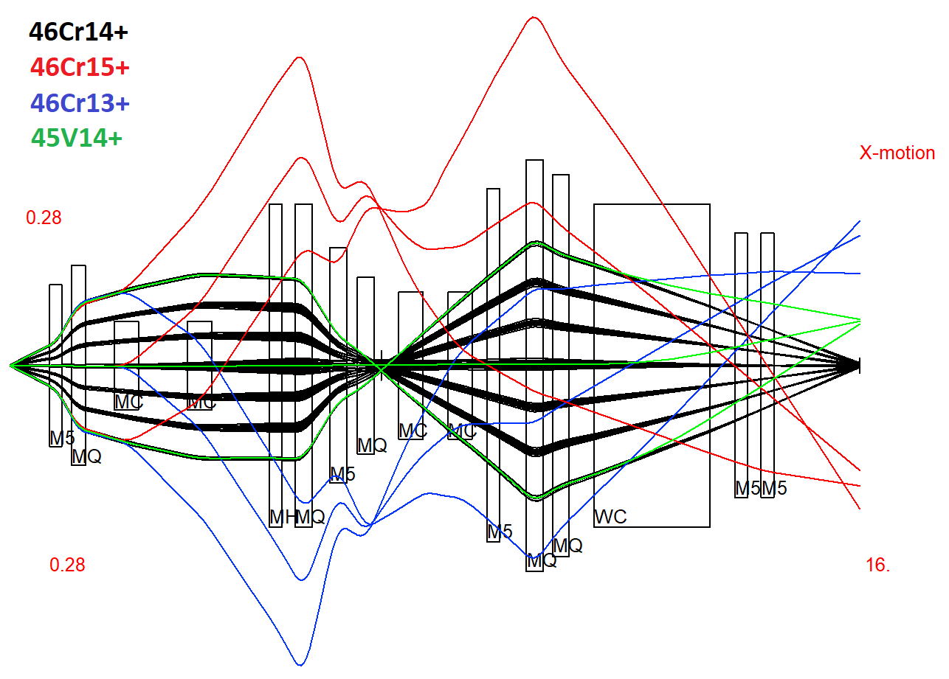
Recoil tracking

