Slide 1
Some questions from Lecture 2 (Berg):
1) Does COSY allow implementation of higher order corrections in dipoles?
2) Why dipoles doublets instead of one large dipole?
3) Definition of K, T, and C in dispersion matching.
4) Define fringe field.
5) Define Rogowski profile.
6) Explain H and K coil in K600 Spectrometer. Why quad inside K600?
7) Explain HO in K600 Spectrometer.
8) How to use reconstruct the scattering angle at target from focal plane measurement? Setup of
multi-slit for angle calibration, drift between target and multi-slit.
9) Discuss only one spectrometer (e.g. K600, Grand Raiden, Big Karl).
10) Explain magnetization of ferro-magnetic material.
11) p. 14 Why not 0 deg with beam (for dispersion matching)?
12) Will permanent magnet saturate material. Similar to coil generated fields?
13) Why is dispersion matching needed?
14) Can EFL be measured?

Slide 2
Question 1)
Does COSY allow implementation of higher order corrections in dipoles?
Answer: Yes!
For midplane radial field dependence use e.g. COSY command MS
For entrance and exit pole shapes use e.g. MC command

Slide 3
Question 2)
Why dipoles doublets instead of one large dipole?
Answer: Many possible reasons
Two dipole have more (four) entrance and exit edges allowing higher order corrections (MC command)
Correction of beam misalignment (dog leg) in dispersive directions, without additional space.
One magnet design may not be practical, e.g. too heavy, too different, different gaps, etc.

Slide 4
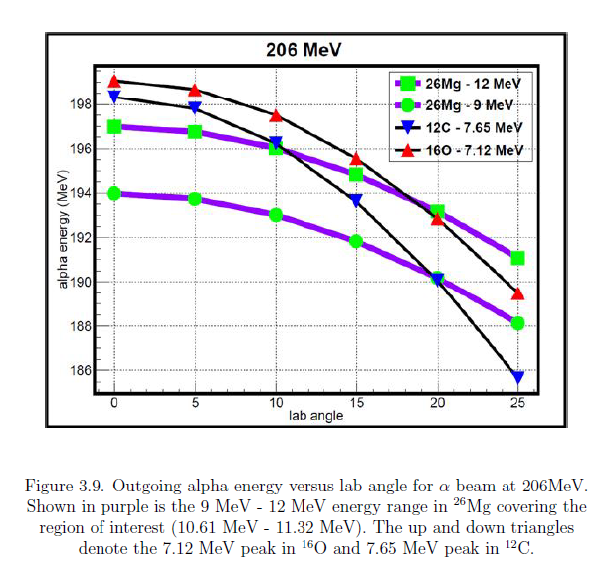
Question 3)
Definition of K, T, and C in dispersion matching.
Answer: See kinematics example at right for K and
see next slide

Slide 5
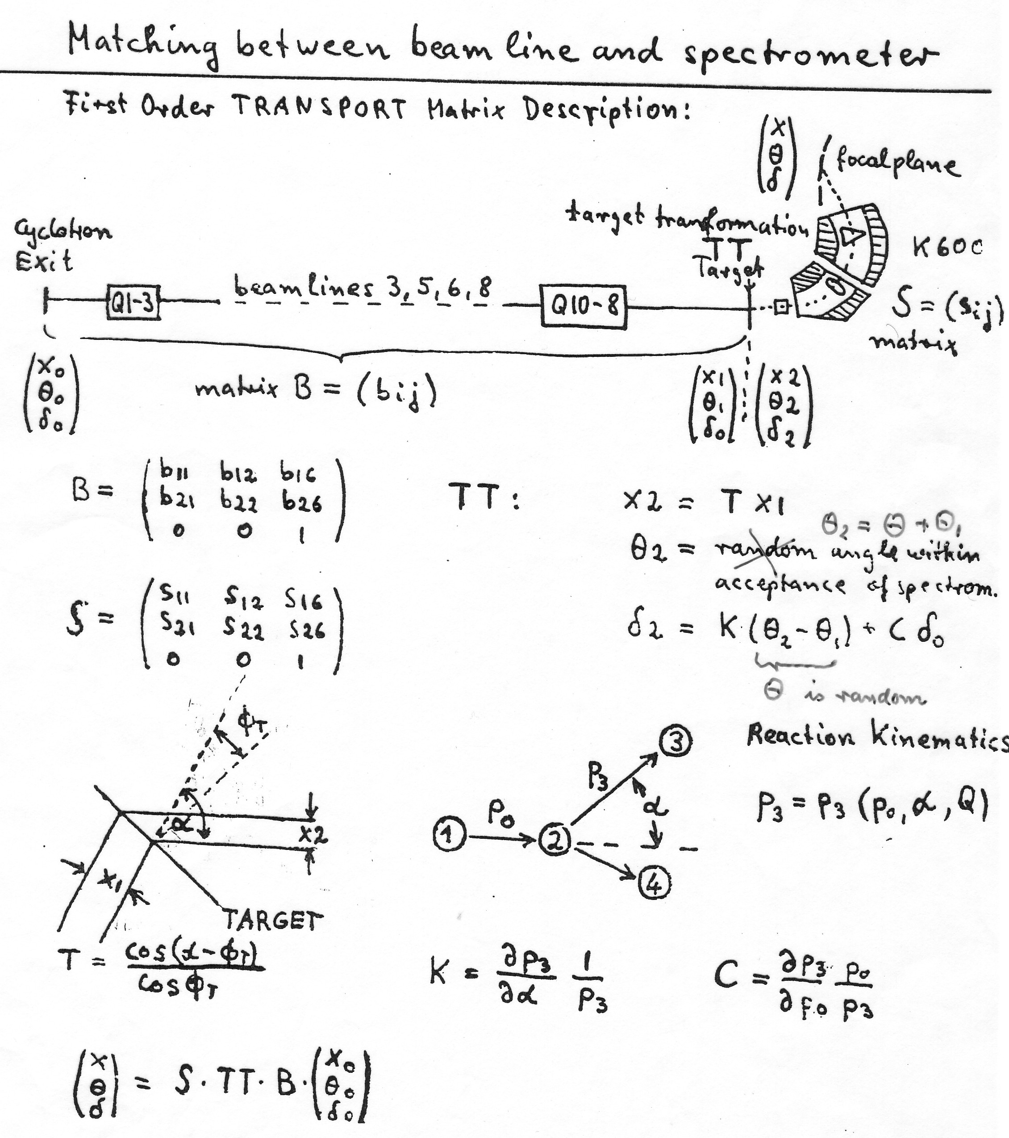
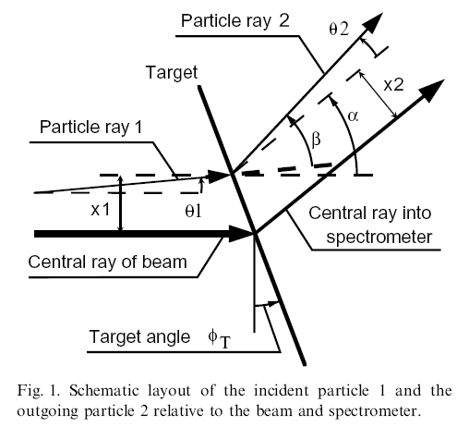
Dispersion Matching
High resolution experiments
Secondary beam (large dp/p)

Slide 6
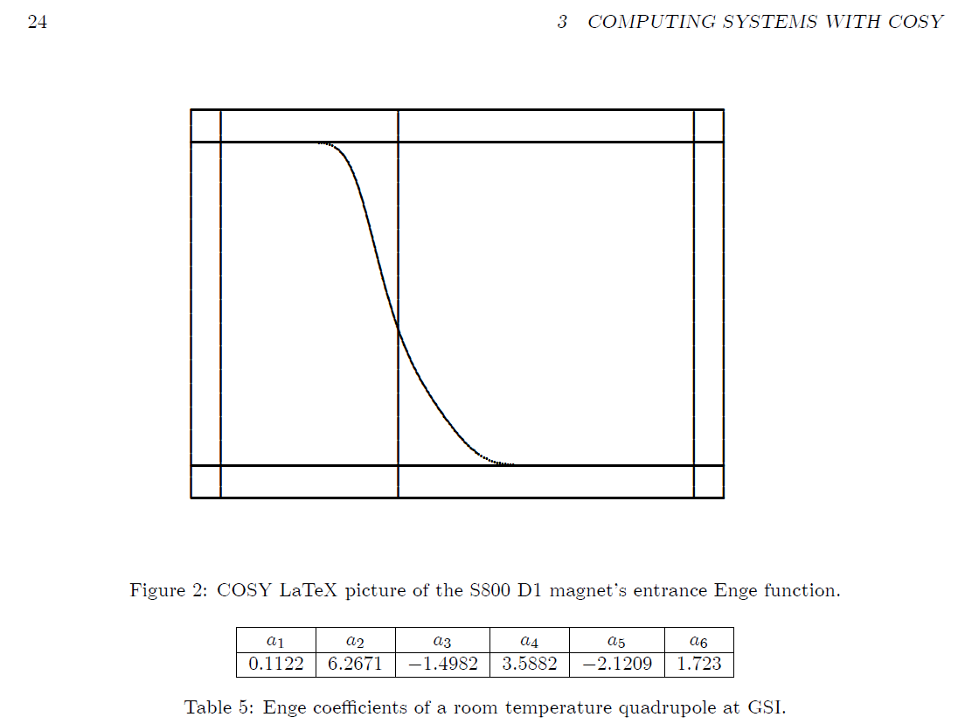
Question 4)
Define fringe field.
Answer: See COSY Beam Manual p 20 Chapter 3.3.2

Slide 7
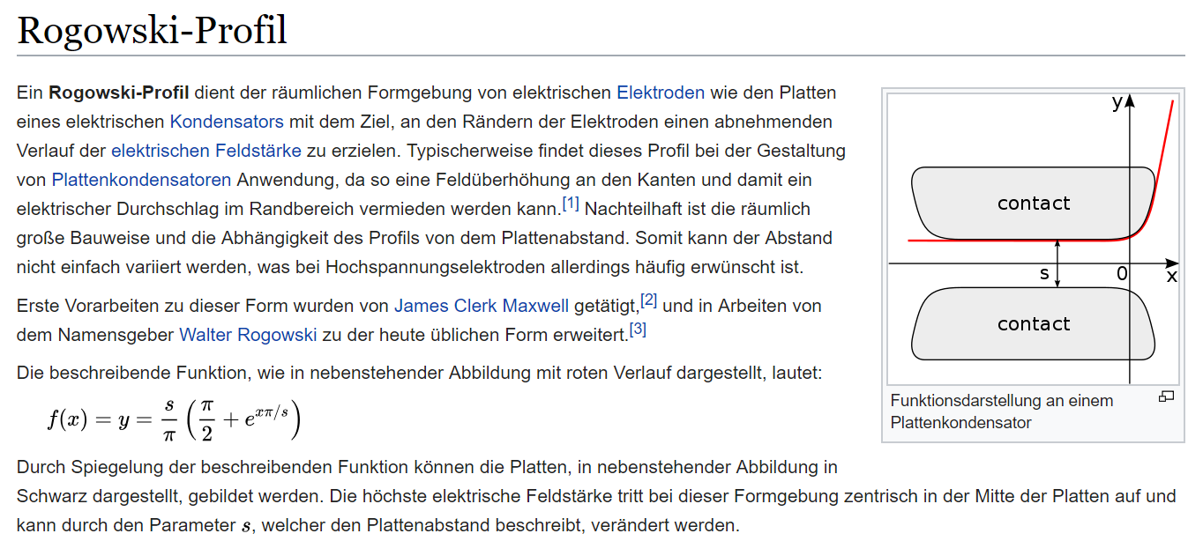
Question 5)
Define Rogowski profile.
Answer: Curve that follows equipotential lines, e.g. in magnet end profiles to
minimize saturation effects.

Slide 8
Question 6)
Explain H and K coil in K600 Spectrometer. Why quad inside K600?
.
Answer: H and K coil in the K600 Spectrometer are the names for the hexapole and quadrupole coil inside the gaps of
Dipole 1 and Dipole 2, respectively. See next slide.
Compact design.

Slide 9
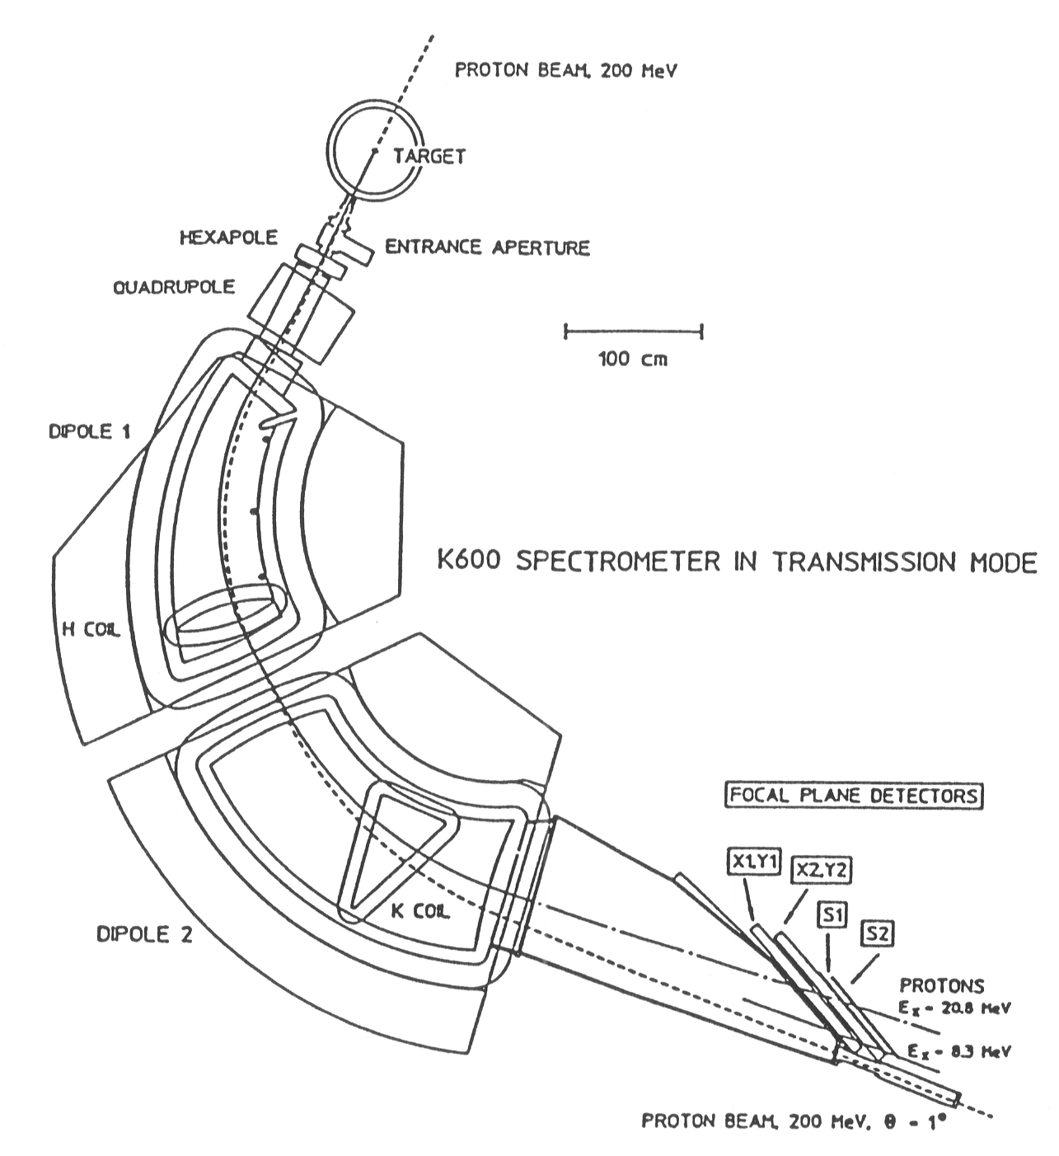
K600 Spectrometer
Bending radius ρ₀ = 2.0 m
B_{max} = 1.7 T
Gap = 5 cm (D 1), 6cm (D2)
Weight = ~ 30 tons (D1)
~ 45 tons (D2)
Medium Dispersion: B(D1)= B(D2)
Resolving power: p/Δp = 20000
Dispersion = 12 cm/% ( = 12 m )
Magnification M_{x} = 0.41
Large range: E_{min} /E_{max} = 1.14
(x|φ²)
(x|Θ²)
3 dispersion modes
(low,medium,high)
set by D2/D1 ratio
Kinematic correction: K coil
Hexapole correction: H coil
The K600 is shown in
0º Transmission mode
High Dispersion Plane
B(D1) > B(D2)
low
medium
(x|Θ)
high
IUCF K600,decommissioned In 1999, now in WS line RCNP
iThemba Labs K600,
South Africa in use

Slide 10
Question 7)
Explain HO in K600 Spectrometer.
Answer: These are the first and second higher order aberrations of the spectrometer that can be corrected
by the magnet next to the aberrations. See previous slide.

Slide 11
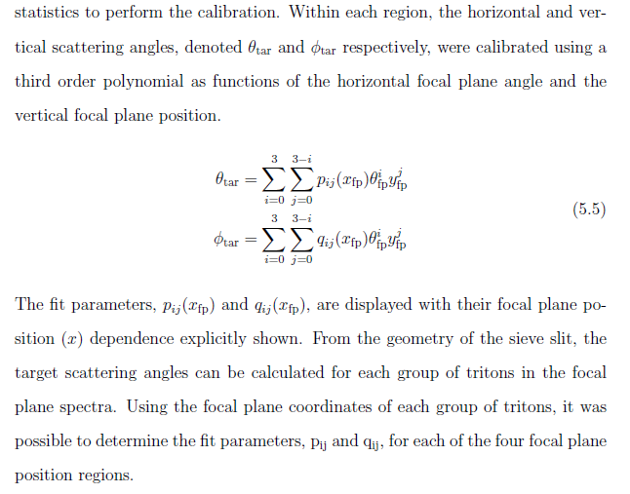
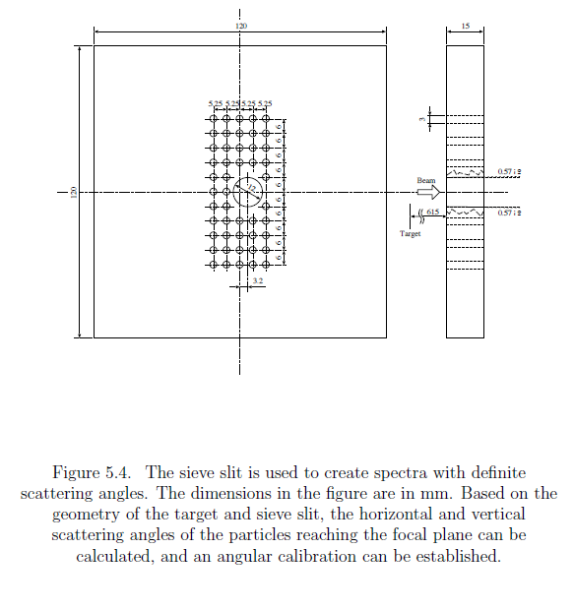
Question 8)
How to use reconstruct the scattering angle at target from focal plane measurement? Setup of multi-slit for angle calibration, drift between target and multi-slit
Answer: Multi-silt as shown below, see result next page

Slide 12
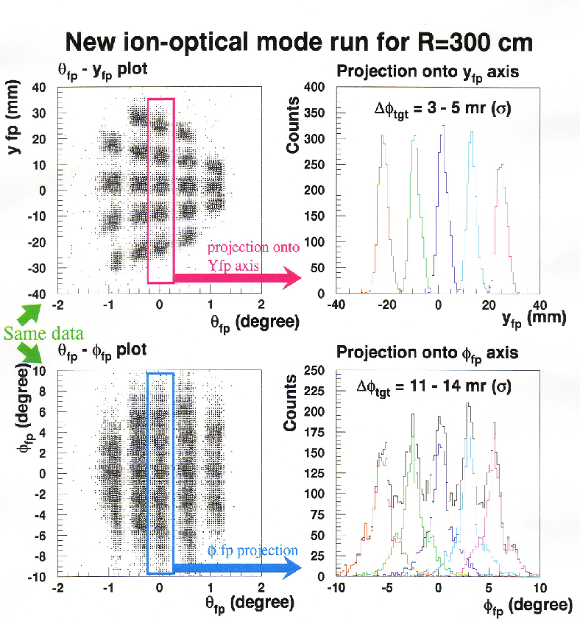
Grand Raiden Angle Calibration
Data suggest: Use y_{fp} not Φ_{fp} to calibrate angle!
Over-focus mode (b)
Calibrated!

Slide 13
Question 9)
Discuss only one spectrometer (e.g. K600, Grand Raiden, Big Karl) to explain dispersion matching
Answer: The discussion of 3 spectrometers were meant to show specific features of these spectrometers
The dispersion matching applies to all three. I will make that clearer the next time.

Slide 14
Question 10)
Explain magnetization of ferro-magnetic material.
Answer:

Slide 15
Question 11)
p. 14 Why not 0 deg with beam (for dispersion matching)?
Answer: Dispersion matching at 0 deg for k= 0 is possible with faint (attenuated beam), see slide 5, also 4
Why is dispersion matching needed?

Slide 16
Question 14)
Can EFL be measured?
Answer: The best method is to measure the field distribution along the central ray ( or a ray parallel to the central ray) and use the definition, see below.

