Slide 1
Some questions from Lecture 1 (Berg):
1) Why are the dots on the “Diagnostics in focal plane of Spectrometer” so evenly spaced?
2) What is the real world example of measuring emittance?
3) Describe the focal plane diagnostics of the spectrometer in more detail
4) l doesn't appear to have a dependence on anything. Can you clarify how l(t) transforms? How exactly is l define?
5) Can you show a (x|a)!=0 case
6) Why is sigma matrix symmetric? What is definition of sigma_21? How do we create the 6×6 ellipse matrix?
7) How does the x-Theta measurement setup look like (measure orientation of ellipse)
8) Definition of Louisville Theorem
9) How do we define the central ray?
10) R11, R12, R21, R22 - can more than one be zero?

Slide 2
Question 1)
Why are the dots on the “Diagnostics in focal plane of Spectrometer” so evenly spaced?
Answer: This is an artifact of poor binning, see next slide upper scatter plot Theta vs. x1 position.
This was corrected in the lower scatter plot on the next slide

Slide 3
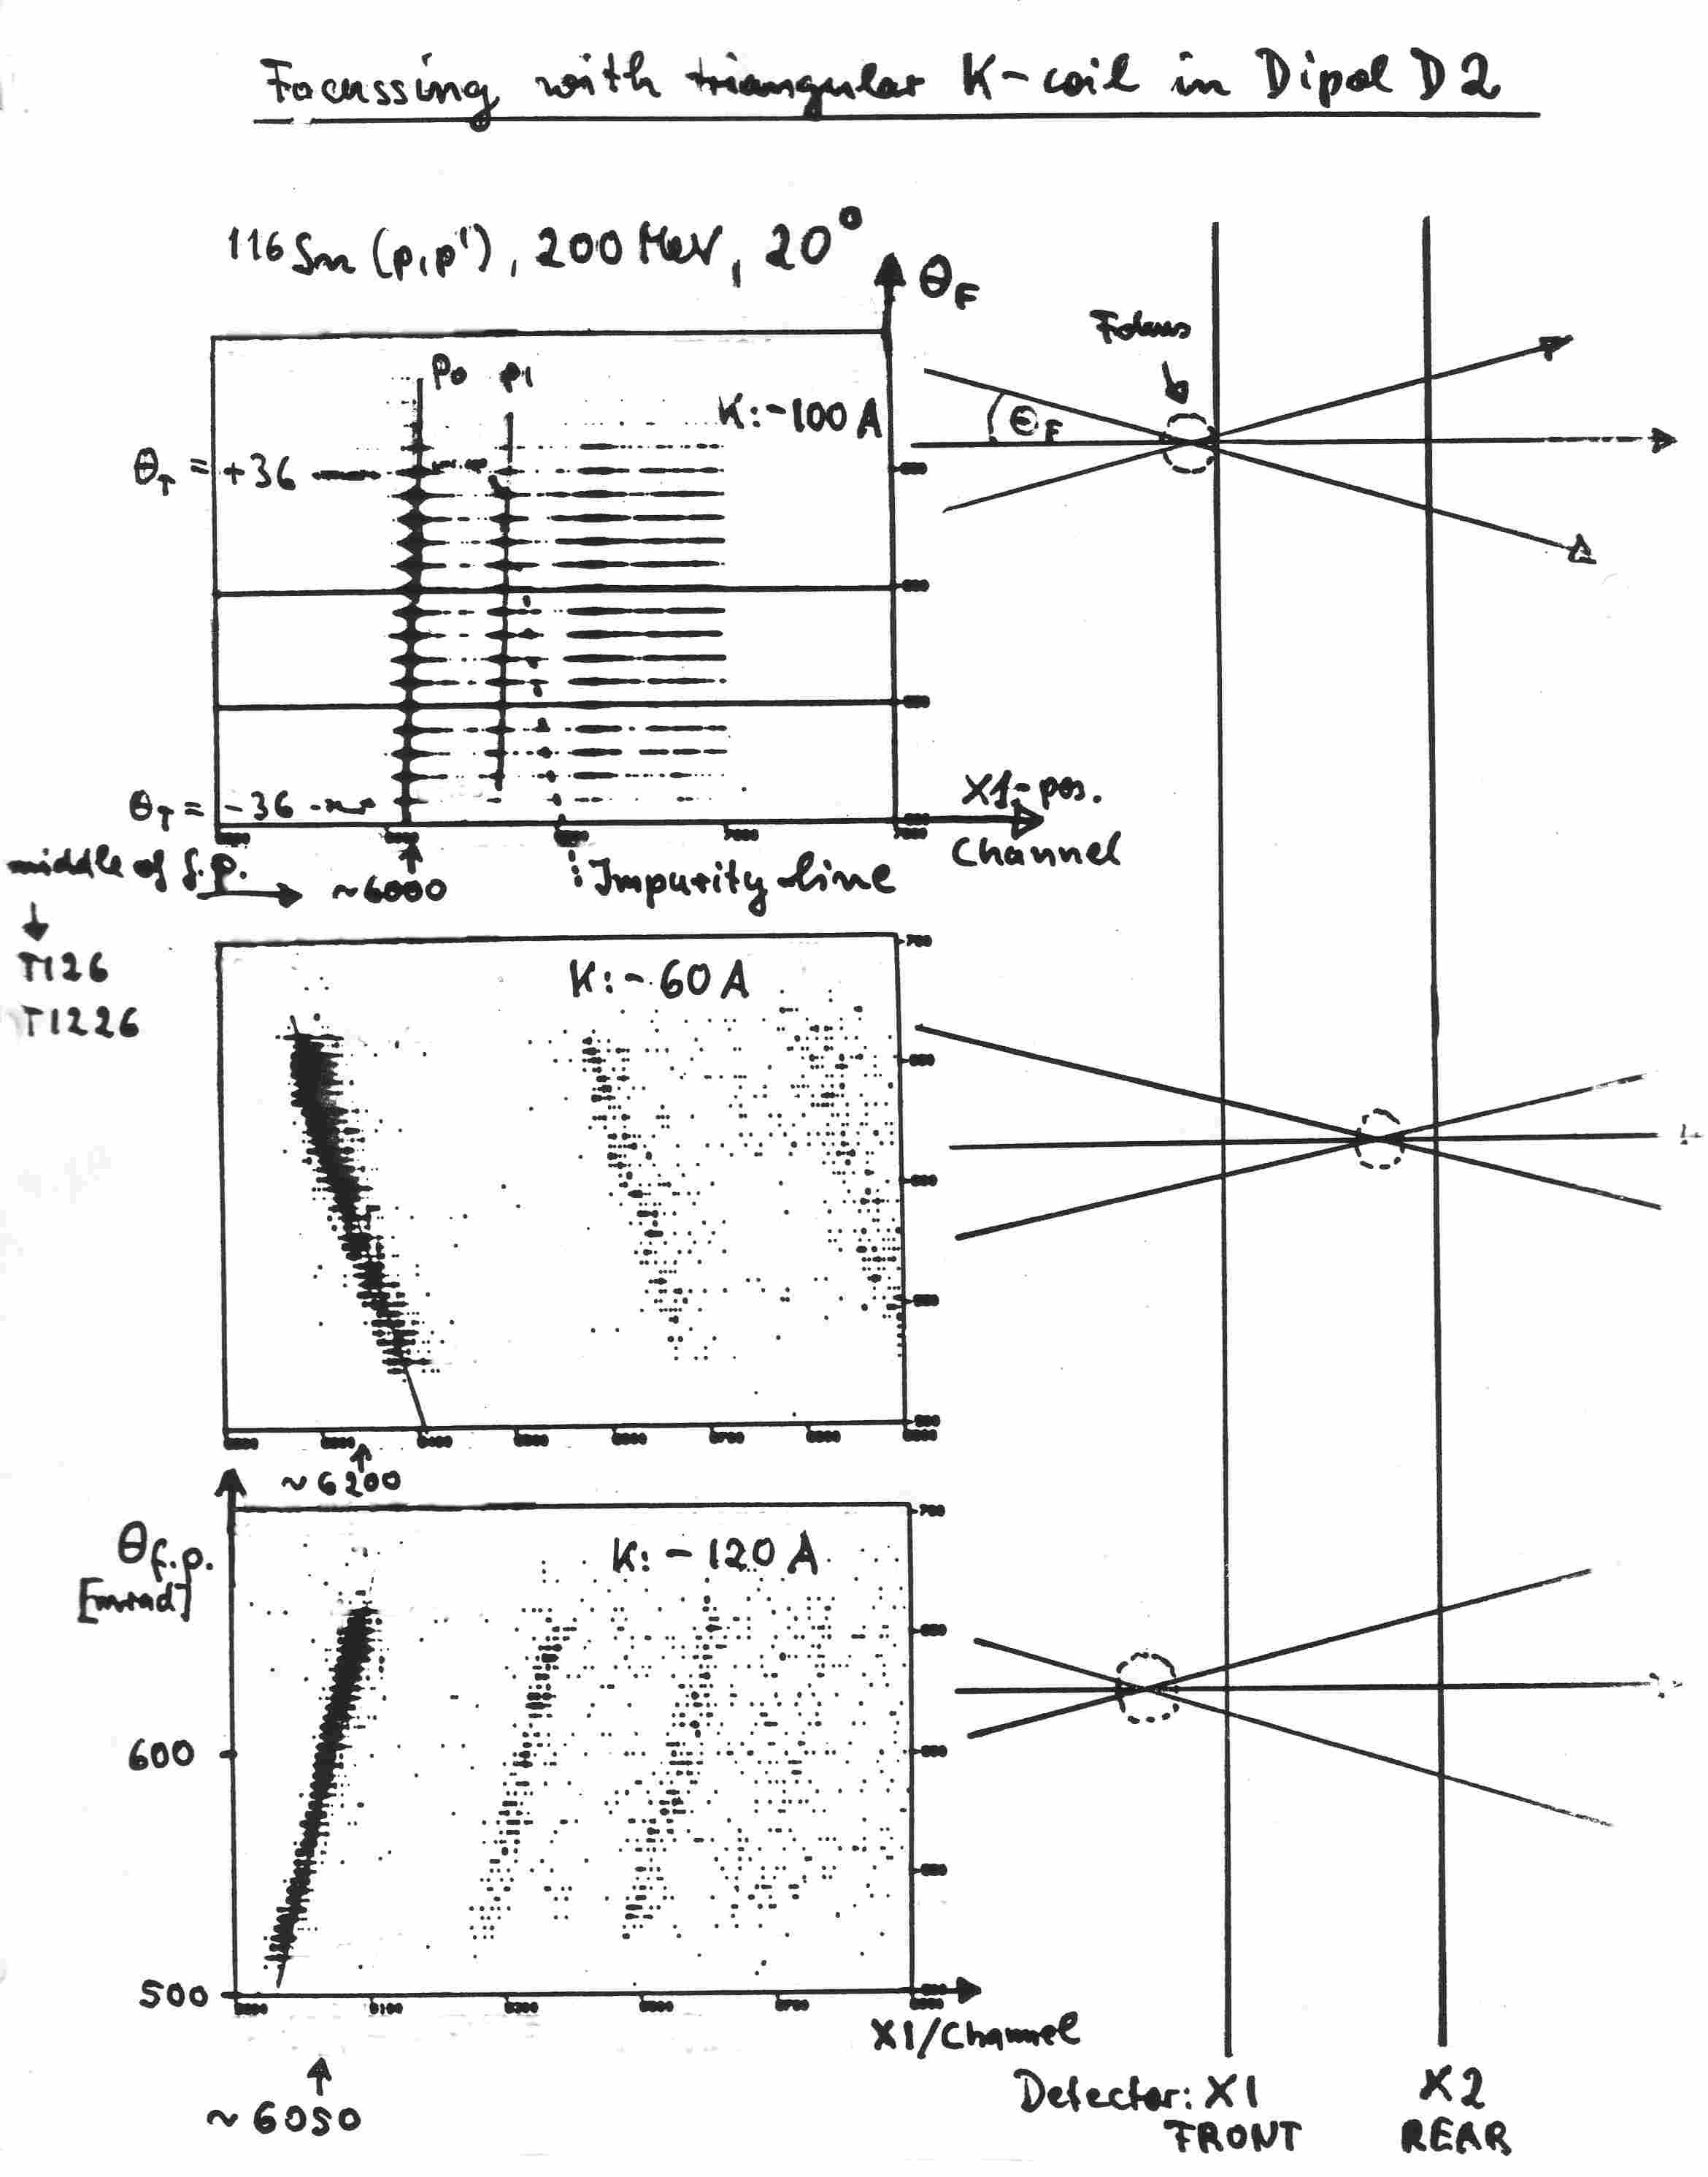
Diagnostics in focal plane of spectrometer
IUCF, K600 Spectrometer
Typical in focal plane of
Modern Spectrometers:
Two position sensitive
Detectors:
Horizontal: X1, X2
Vertical: Y1, Y2
Fast plastic scintillators:
Particle identification
Time-of-Flight
Measurement with IUCF K600
Spectrometer illustrates from top
to bottom: focus near, down-
stream and upstream of
X1 detector, respectively

Slide 4
Question 2)
What is the real world example of measuring emittance?
Answer: A real world measurement would have been done in an existing device. Since we do not have such
we use “calculated data” for the exercise.

Slide 5
Question 3)
Describe the focal plane diagnostics of the spectrometer in more detail
Answer: See next slide of K600 with focal plane detector system. The see slide 3
with x-Theta plot for detailed explanation.

Slide 6
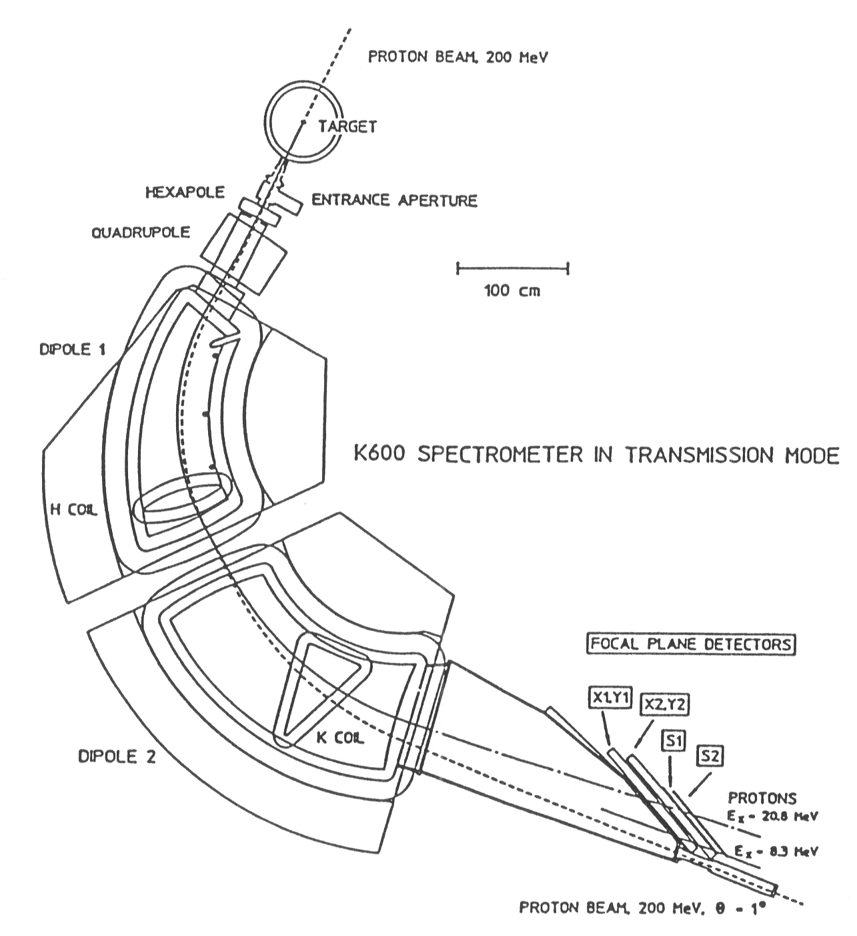
K600 Spectrometer
Bending radius ρ₀ = 2.0 m
B_{max} = 1.7 T
Gap = 5 cm (D 1), 6cm (D2)
Weight = ~ 30 tons (D1)
~ 45 tons (D2)
Medium Dispersion: B(D1)= B(D2)
Resolving power: p/Δp = 20000
Dispersion = 12 cm/% ( = 12 m )
Magnification M_{x} = 0.41
Large range: E_{min} /E_{max} = 1.14
(x|φ²)
(x|Θ²)
3 dispersion modes
(low,medium,high)
set by D2/D1 ratio
Kinematic correction: K coil
Hexapole correction: H coil
The K600 is shown in
0º Transmission mode
High Dispersion Plane
B(D1) > B(D2)
low
medium
(x|Θ)
high
IUCF K600,decommissioned In 1999, now in WS line RCNP
iThemba Labs K600,
South Africa in use

Slide 7
Question 4)
l doesn't appear to have a dependence
on anything. Can you clarify how l(t)
transforms? How exactly is l define?
Answer: l(t) = R651*x_0+R52*Theta_0+l_0+R5*delta_0

Slide 8
Question 5)
Can you show a (x|a)!=0 case?
Answer: See slide 3

Slide 9
Question 6)
Why is sigma matrix symmetric? What is definition of sigma_21? How do we create the 6×6 ellipse matrix?
Answers: See this and next 2 slides
Ellipse in matrix form, see TRANSPORT MANUAL p. 169
To make an ellipse the sigma matrix has to fulfill the following conditions
Real
Positive definite: det(sigma) > 0 (Note: Area of ellipse is A = Pi*epsilon)
Symmetric (sigma(n) = sigma(m) for m not equal n

Slide 10
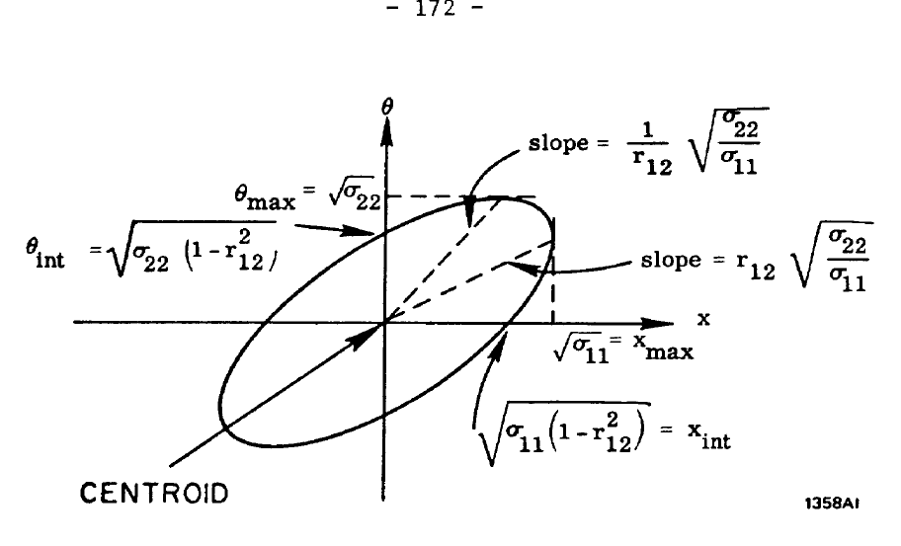
sigma 21 = sigma 12 represents the tilt of the ellipse and is in the ellipse drawing via r12

Slide 11
Symmetric sigma of 6 dimensional ellipsoid

Slide 12
Question 7)
How does the x-Theta measurement setup look like (measure orientation of ellipse)
Answer: See slide 6 of K600 with focal plane detector system. The see slide 3
with x-Theta plot for detailed explanation. Caveat. Beam intensity may be too high
for detector system. Use attenuated (faint) beam.

Slide 13
Question 8)
Definition of Louiville Theorem
Answer: Liouville’s Theorem states that “The density of states in an ensemble of many identical states
with different initial conditions is constant along every trajectory in phase space”.
Applied to our case is means that the emittance epsilon (area/volume of the ellipse) does not change
Under conservative forces. Conservative forces F are forces where the work (integral F dl) is independent
of the path.

Slide 14
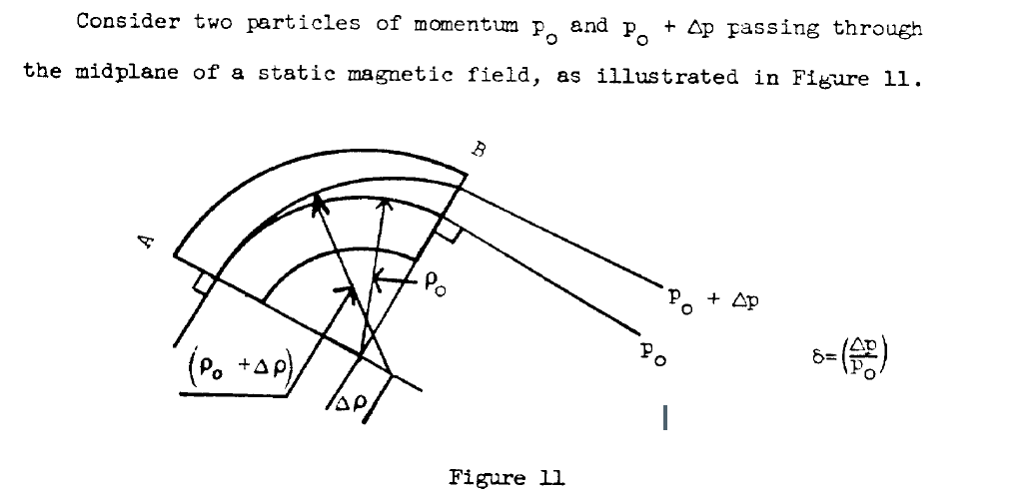
Question 9)
How do we define the central ray?
Answer: The Central Ray is a fictitious line through the magnetic center of quadrupoles. For passage through
dipoles see drawing below, TRANSPORT manual p. 136

Slide 15
Question 10)
R11, R12, R21, R22 - can more than one be zero?
Answer: If R12=0 it follows that R11 = 1/R22. I do not think R21 = 0 has a physical meaning. But I do not have a proof. Note that this is the Transfer matrix, not the symmetric matrix that defines an ellipse. So R is not necessarily symmetric.

