Slide 1
COSY Infinity Summer School
BAM Group

Slide 2
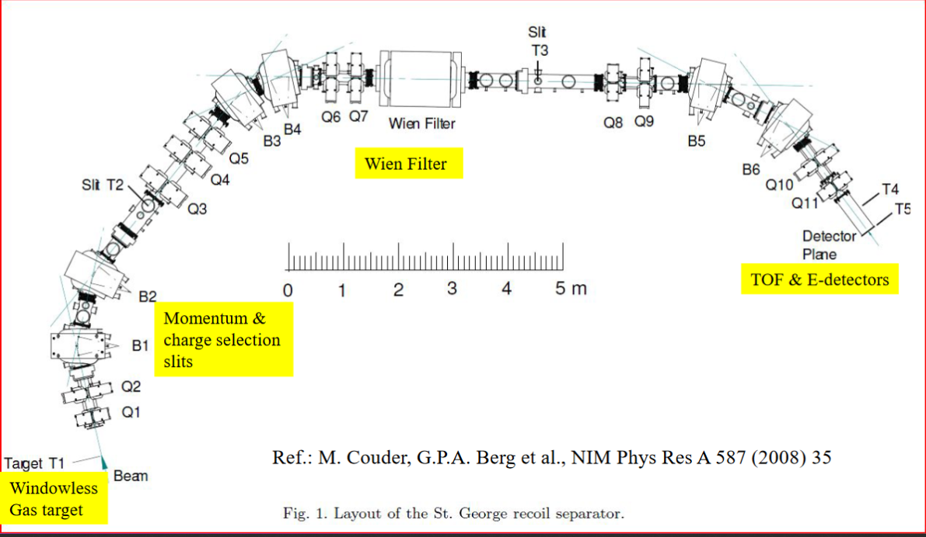
St. George
From G. Berg lecture 3

Slide 3
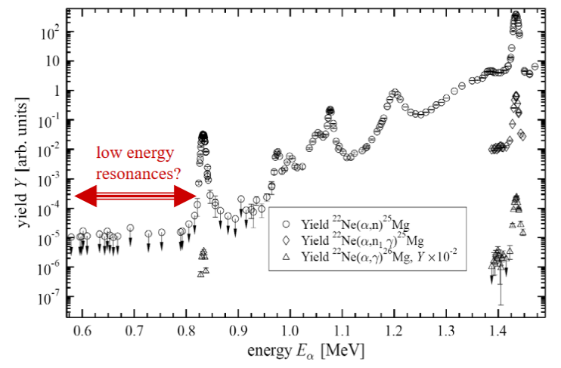
²²Ne(α,n)²⁵Mg
Key neutron source in astrophysical s-process
Low energy resonances are difficult to measure due to low cross sections

Slide 4
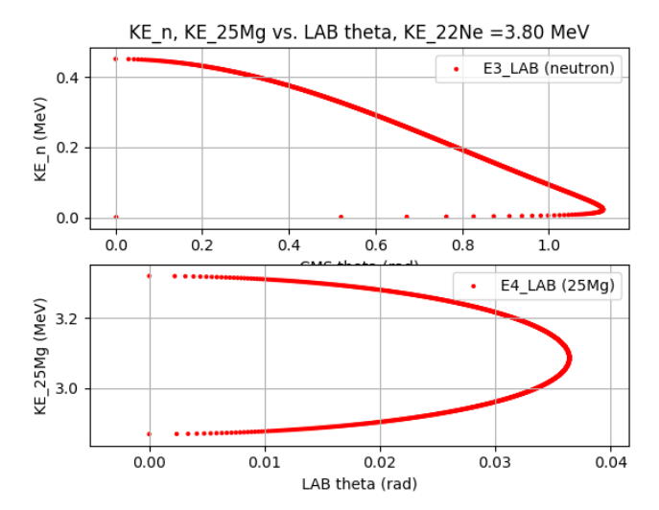
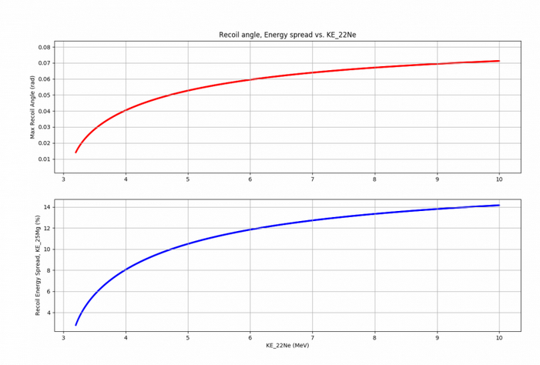
Kinematics Calculations

Slide 5
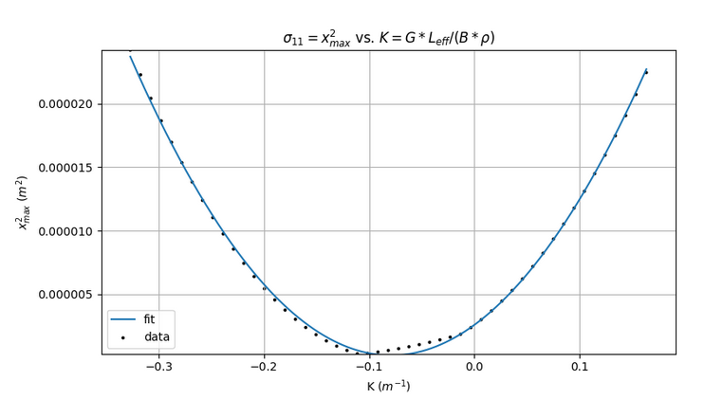
Emittance Calculation
Model: P1*x^2 + P2*x + P3
P1 = 3.82e-04+/-2.03e-06 m^2
P2 = 6.05e-05+/-4.22e-07 m^3
P3 = 2.59e-06+/-5.20e-08 m^2
ε = 0.2 mm*mrad

Slide 6
Problem 8
Value Changed | Amount of change to decrease mass resolution by 5%
Beam position | Change x-position by 0.5 mm
Beam size | Increase X variable by .1 mm
Q3 length | Increase length by 2 mm
Shift in Q3 position | Shift by .5 mm in x Shift by 5 mm in y
Shift in Q3 pitch | .05˚
Shift in Q3 roll | .15˚
Shift in Q3 yaw | 2.3˚

Slide 7
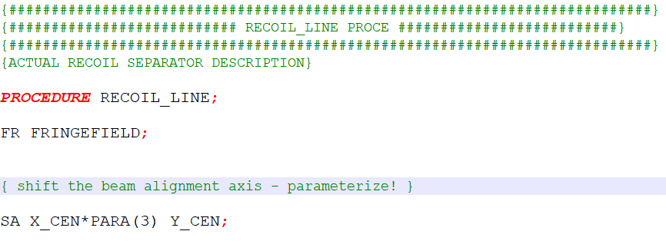
You can use the one remaining variable to parameterize the ‘knob’ you want to turn
COSY beam manual SECTION 5.2 – MAPS WITH KNOBS

Slide 8
1ST ORDER TERMS OF MAP – WITH NEW PARAMETER
THIS IS THE FIRST ‘ROW’ OF THE MAP, IE. X|X, X|A, ETC
Command: ME(1,7) – first order
MEP(1,7) – full expansion

Slide 9
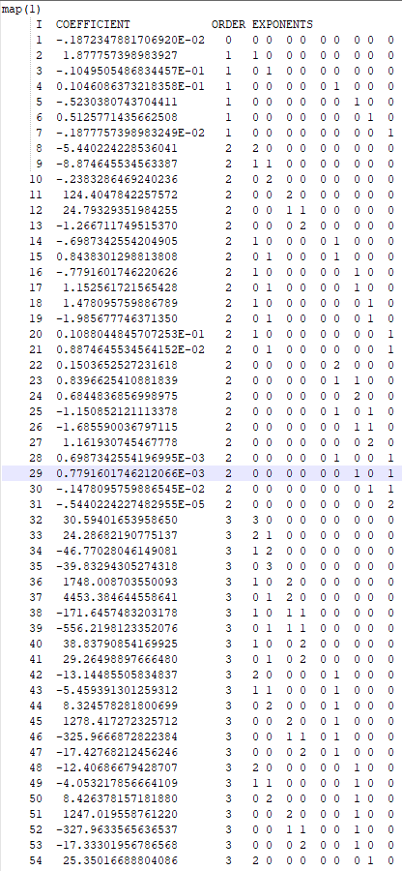
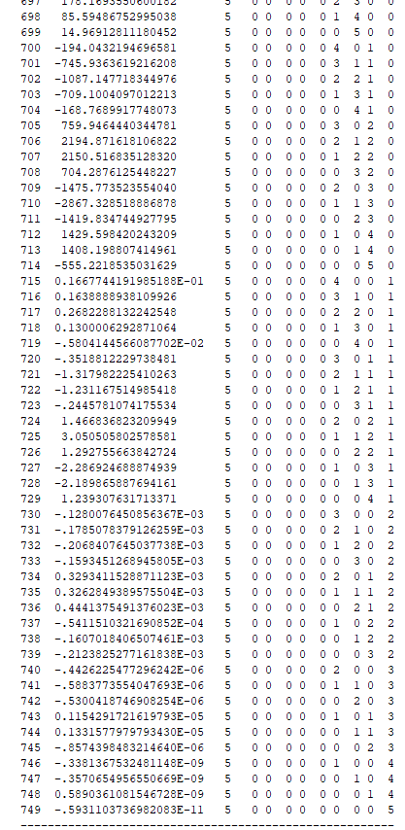
700+ TERMS IN FIRST ROW
ONLY TO 5TH ORDER!
…
BEAM AXIS OFFSET PARAMETER IS THE 9TH VARIABLE – MAP CONTAINS
EXACT BEHAVIOR OF THIS PARAMETER
TO 5TH ORDER

